Slide 1
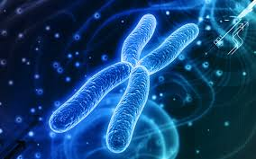
DNA and Genes

Slide 2
The Genetic Code found in the DNA of all organisms is how cells store information and pass it from one organism to organisms of the next generation.

Slide 3
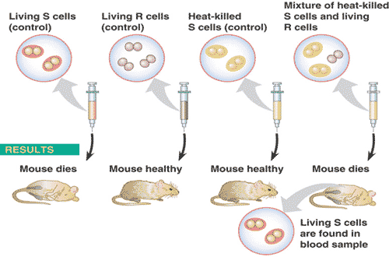
How do we know that DNA is the genetic material?
Griffith and Transformation

Slide 4
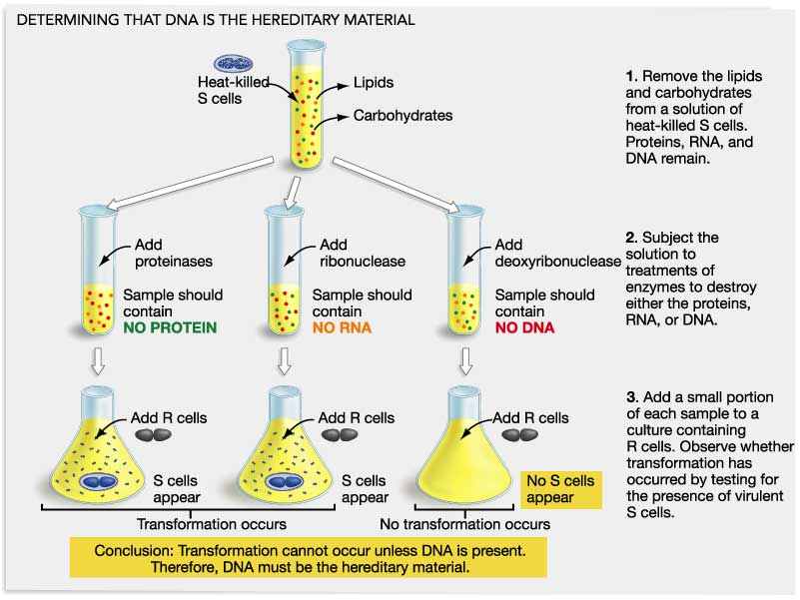
How do we know DNA is the genetic material?
Avery, McCarty, and McCleod

Slide 5
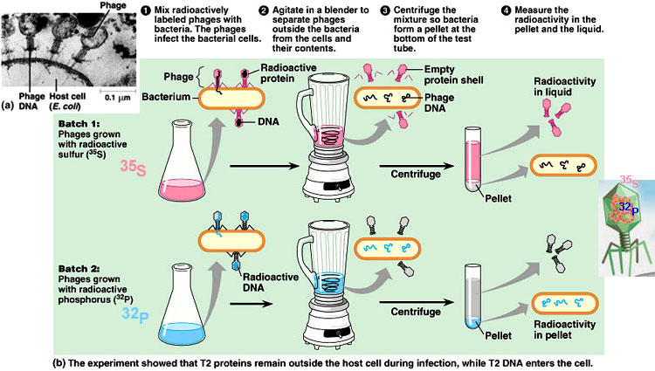
How do we know that DNA is the genetic material?
Hershey and Chase

Slide 6
Structure of DNA
DNA is a polymer of nucleotides. A nucleotide is made of
1) 5 carbon sugar (deoxyibose).
2) a phosphate group
3) one of four nitrogenous bases (adenine A, thymine T, guanine G, or cytosine C)

Slide 8
Structure of DNA
How are the nucleotides arranged:
DNA is in the shape of a double helix (two strands spiral around each other)
The two strands are held together by hydrogen bonds between complimentary bases.
A = T G = C
Sugar and phosphate form the backbone (outside); nitrogenous bases form the inside.

Slide 9
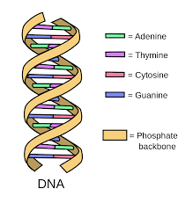
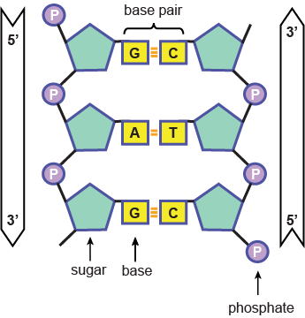
Structure of DNA

Slide 10
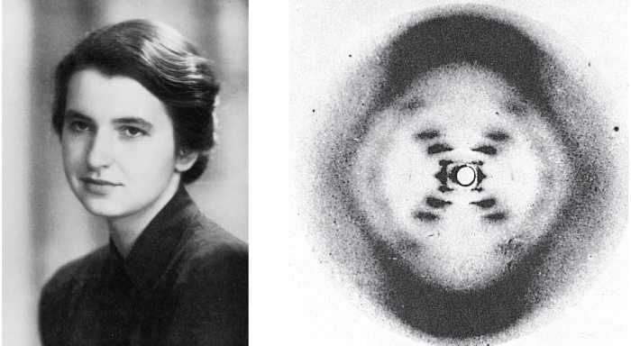
How do we know this?
Rosalind Franklin and Maurice Wilkins using
X-ray diffraction developed a picture of the
DNA molecule and found that it was made up
of two strands. They also found the width
of the molecule and where the strands
turned.

Slide 11
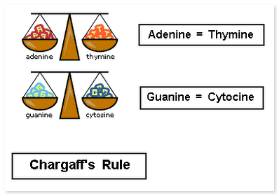
How do we know this?
Chargoff, a Russian scientist chemically analyzed the DNA of many different organisms and came up with “Chargoff’s Rule”.
A = T and G = C

Slide 12
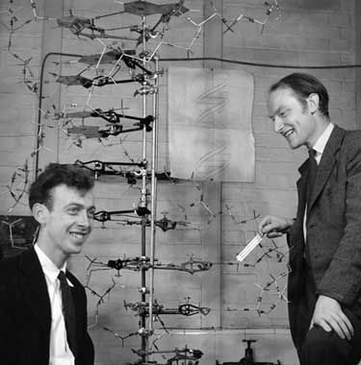
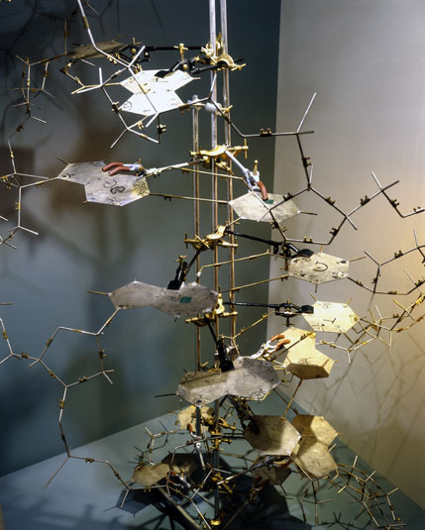
How do we know this?
Watson and Crick used this information. By playing with models, they came up with the Double Helix and won the Nobel Prize for Science in 1958.

Slide 13
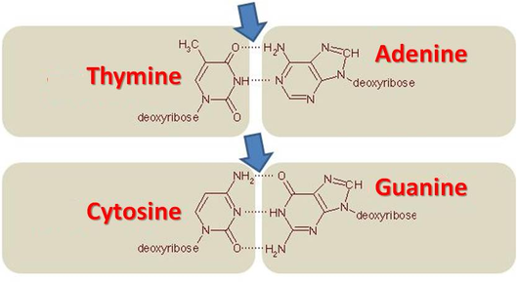
Replication of DNA
DNA strands are complimentary
Each strand has the complete information to make the other strand.
Base pairing is the method used to remake the other strand.

Slide 14
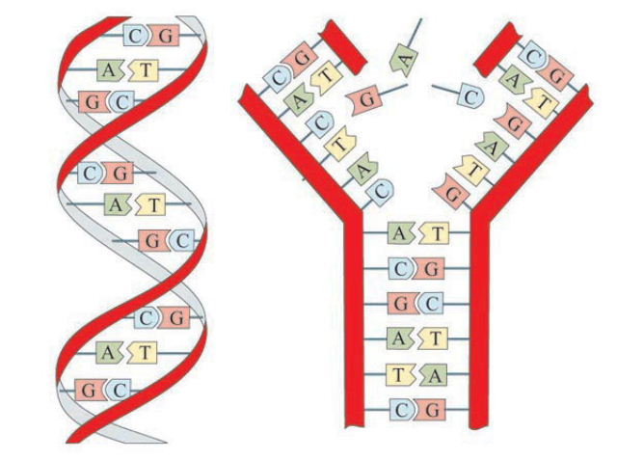
Replication of DNA
When a cell is ready to divide, it must copy its DNA.
Enzymes “unzip” the two strands (separate them)
Enzymes insert the matching bases.
Enzymes connect sugars and phosphates.
Enzymes proofread each strand.

Slide 15
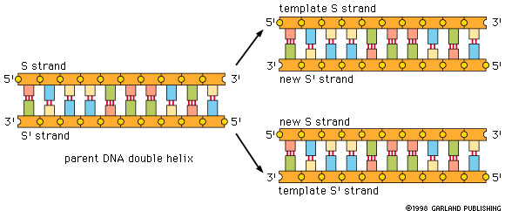
Replication of DNA
Two new strands are formed as the original strand opens. By complimentary base-pairing, the result is two identical double-stranded DNA molecules. If the original strand’s sequence was ATCGCGAAA, the new strand’s sequence is TAGCGCTTT

Slide 16
RNA – Ribonucleic Acid
There are three types of RNA
mRNA – messenger RNA – complimentary copy of section of DNA – except that T’s are replaced by U’s.
tRNA - transfer RNA brings amino acids to ribosomes and base pairs with mRNA codons by anticodons. Also has U’s instead of T’s.
rRNA – combines with proteins to make ribosomes

Slide 17
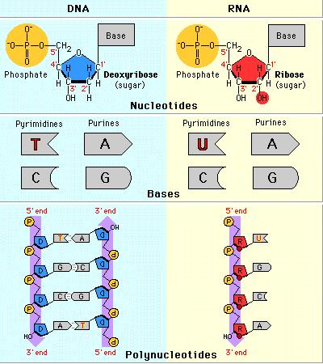
How does RNA differ from DNA
DNA has deoxyribose sugar; RNA has ribose.
DNA has Adenine, Thymine, Cytosine, and Guanine; RNA has Adenine, Uracil, Cytosine, and Guanine.
DNA is double-stranded; RNA is single-stranded.

Slide 18
Transcription
Transcription is the process by which part of a DNA molecule is copied into mRNA.
DNA does not leave the nucleus; RNA is a copy that can leave the nucleus.
Message is carried by mRNA to the ribosomes in the cytoplasm.

Slide 19
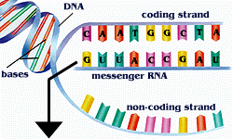

Slide 20
Protein Synthesis
DNA contains information to make proteins.
Proteins (as enzymes) direct synthesis of lipids, carbohydrates, and nucleotides.
Proteins are responsible for cell structure and movement.
Proteins are a chain of amino acids.
Each codon – group of three bases on mRNA specifies a particular amino acid.
There is a start codon “AUG” and three stop codons.

Slide 21
Translation
Translation is the decoding of the mRNA into amino acids.
There are twenty amino acids and each has its own codons.
Codons are groups of three amino acids in the mRNA that specify a particular amino acid.
The genetic code shows which amino acids are used for each codon.

Slide 22
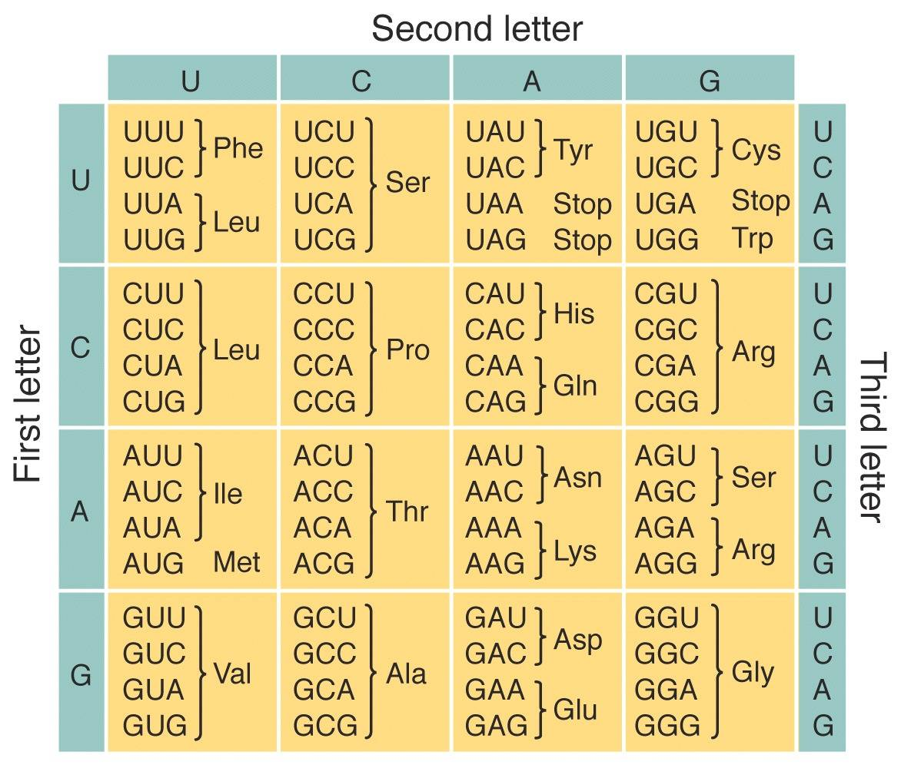
The Genetic Code

Slide 23
Translation
The mRNA attaches to a ribosome.
The first tRNA carries met (the first amino acid in every protein) to the AUG codon on the mRNA.
The tRNA attaches to the mRNA by base-pairing its anticodon to the mRNA codon.
The ribosome moves along the mRNA and forms peptide bonds between the chain and the new amino acid.
Each new tRNA arrives, attaches to the mRNA by its anticodon, delivering its amino acid to a growing polypeptide chain.
When the ribosome gets to a stop codon, the protein and the mRNA are released.

Slide 24
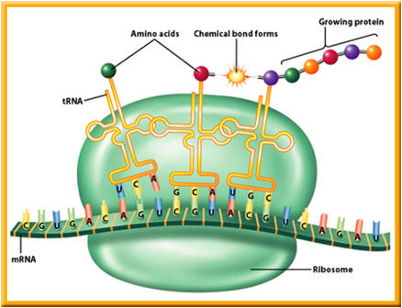
Transfer RNA and Translation

Slide 25
Mutations
Mutations are changes in the DNA sequence.
They may be caused by errors in replication, transcription, cell division, or environmental factors.
Mutations in sex cells are passed on to offspring.
Mutations in body cells are not passed on.

Slide 26
Point Mutations
A point mutation results when a single DNA base in replaced by a different base. This may cause little or no change, but it can change the folding of the protein and result in harm to the organism.

Slide 27
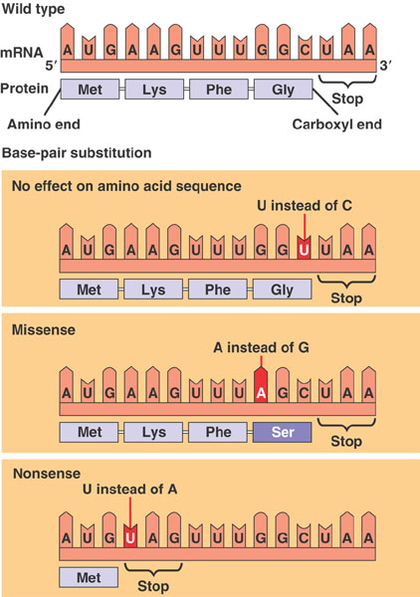

Slide 28
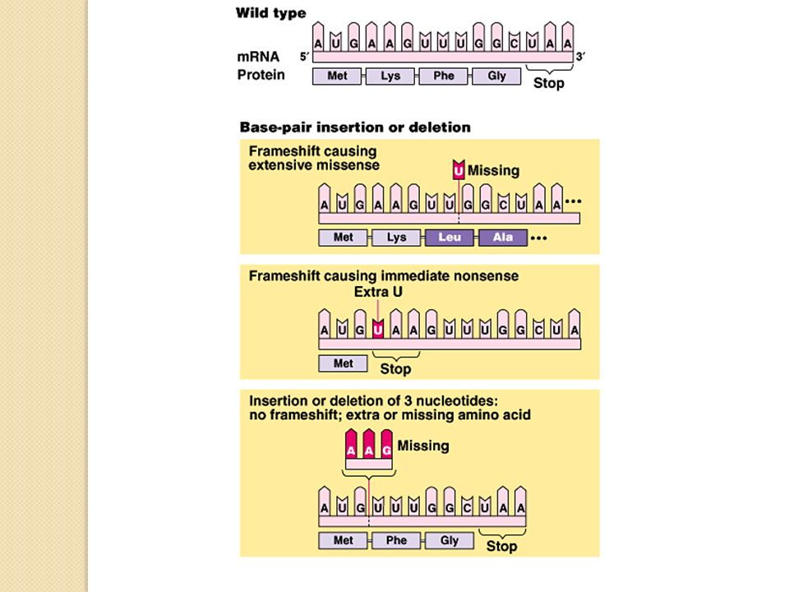
Frameshift mutation

Slide 29
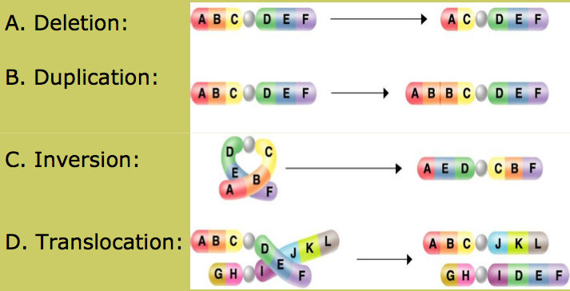
Chromosomal mutations

