Slide 1
What constitutes life?
Living organisms are highly ordered.
Living organisms show evolutionary adaptations.
Living organisms respond to their environment.
Living organisms reproduce.
Living organisms show growth and development.
Living organisms process energy.
Living organism show regulation.

Slide 2
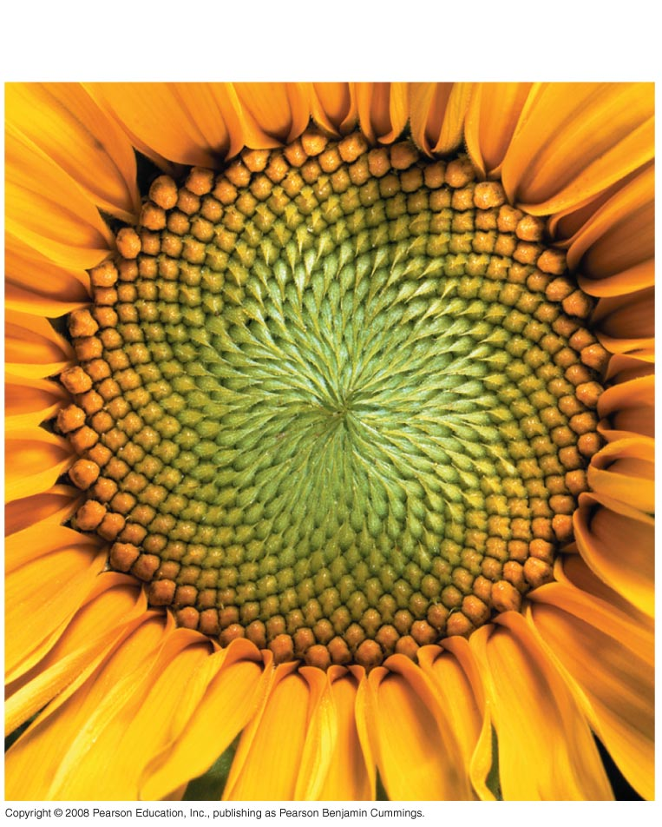
Fig. 1-3a
Order

Slide 3
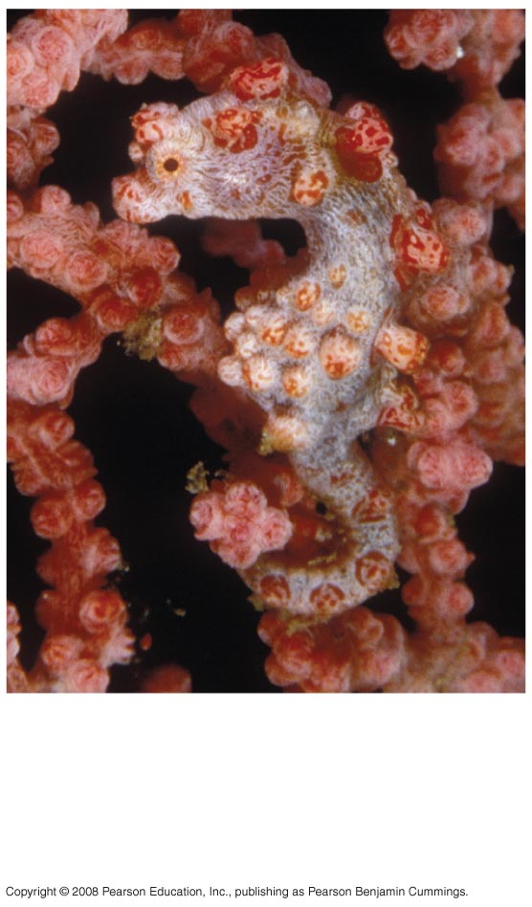
Fig. 1-3b
Evolutionary
adaptation

Slide 4
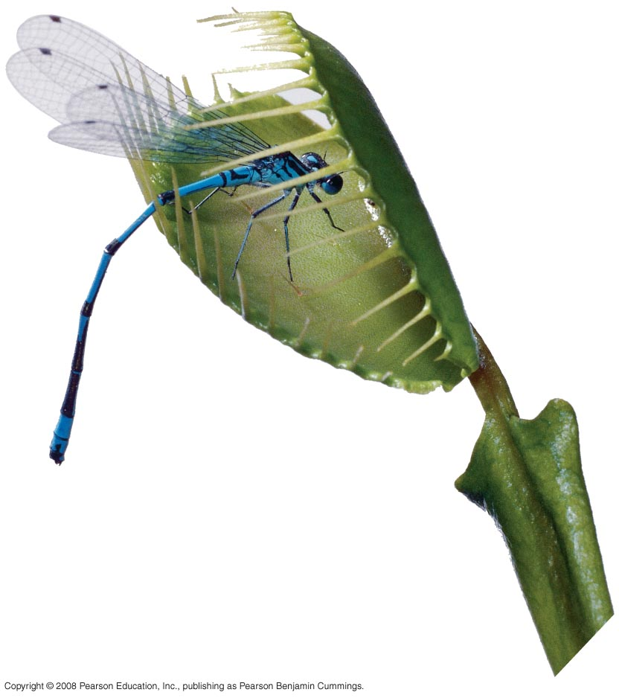
Fig. 1-3c
Response
to the
environment

Slide 5
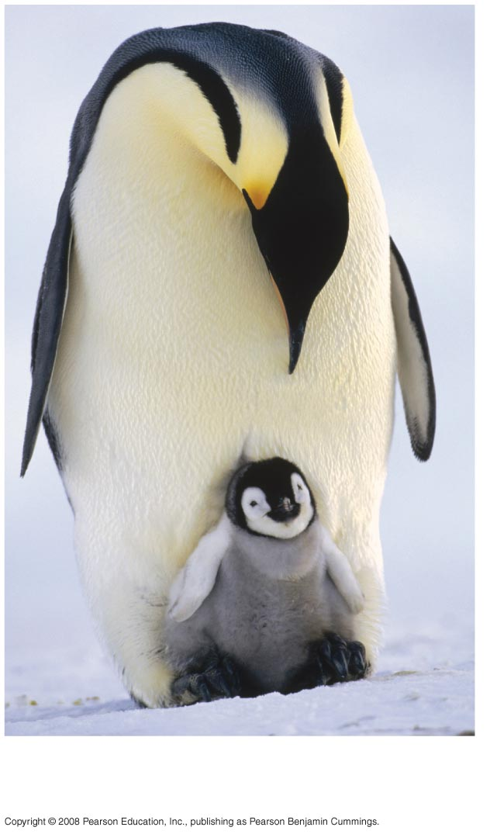
Fig. 1-3d
Reproduction

Slide 6
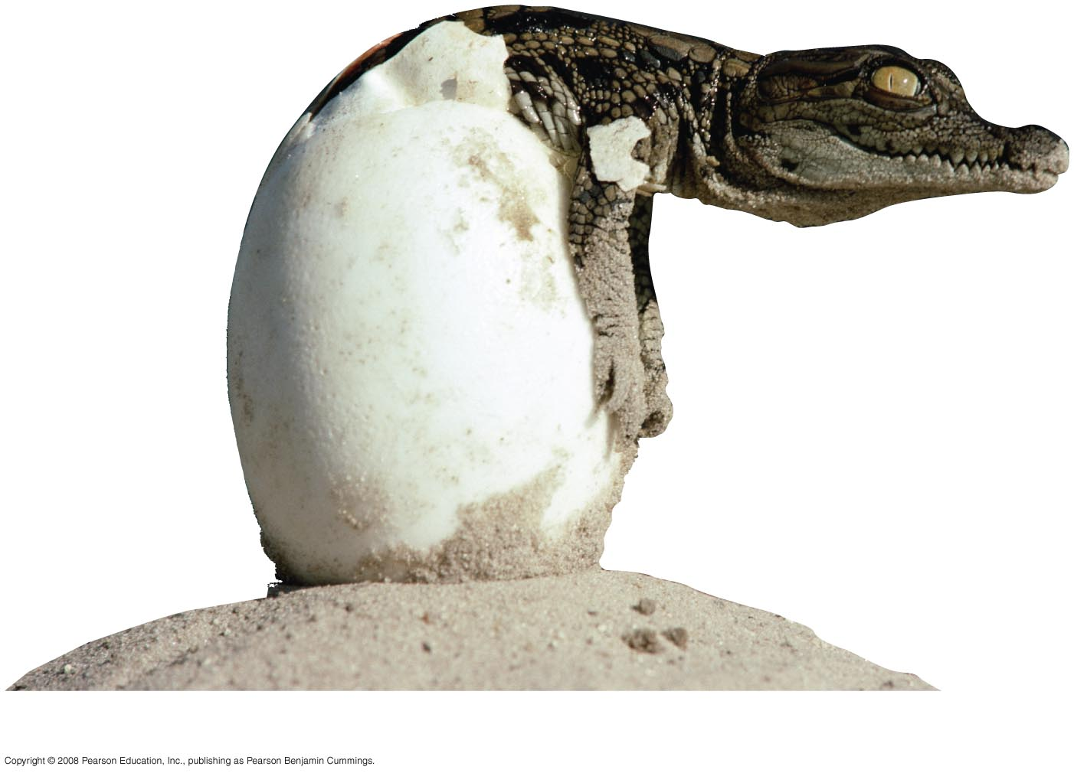
Fig. 1-3e
Growth and development

Slide 7
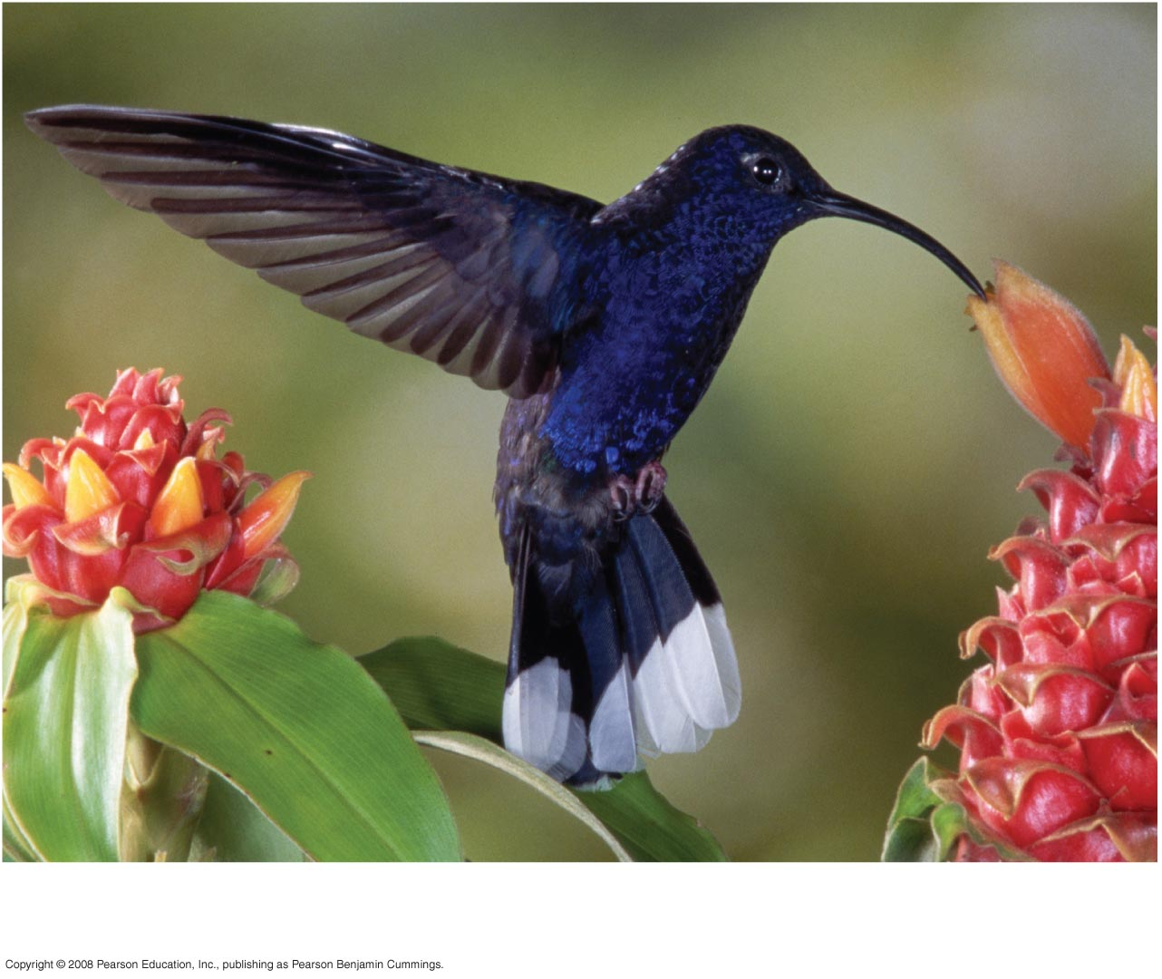
Fig. 1-3f
Energy processing

Slide 8
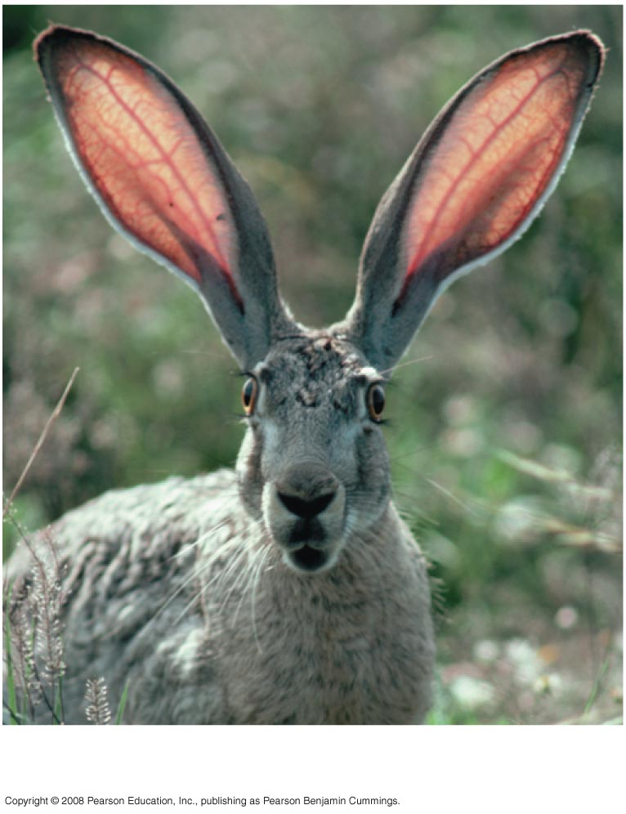
Regulation

Slide 9
Themes in the Study of Life
Themes connect the concepts of biology.
The study of life extends from microscopic scale to the entire living planet. New properties emerge at each level.
Organisms interact with their environments, exchanging matter and energy.
Structure and function are correlated at all levels of biological organization.
The continuity of life is based on heritable information in the form of DNA.
Feedback mechanisms regulate biological systems.
THE CORE THEME: Evolution accounts for the unity and diversity of life.

Slide 10
Biological levels of organization

Slide 11
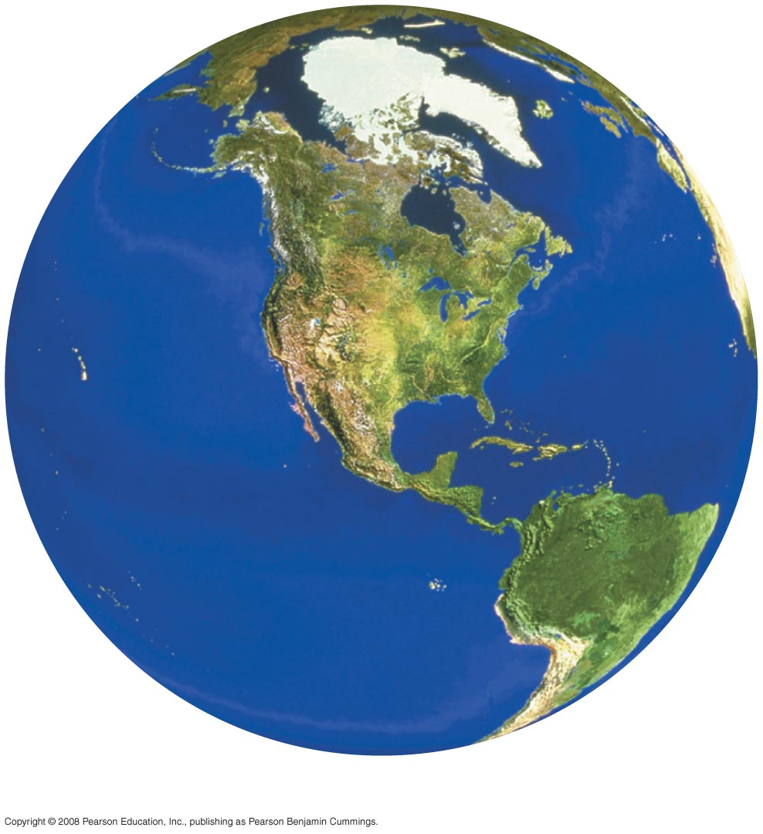
Fig. 1-4c
All environments that are inhabited by life
The biosphere

Slide 12
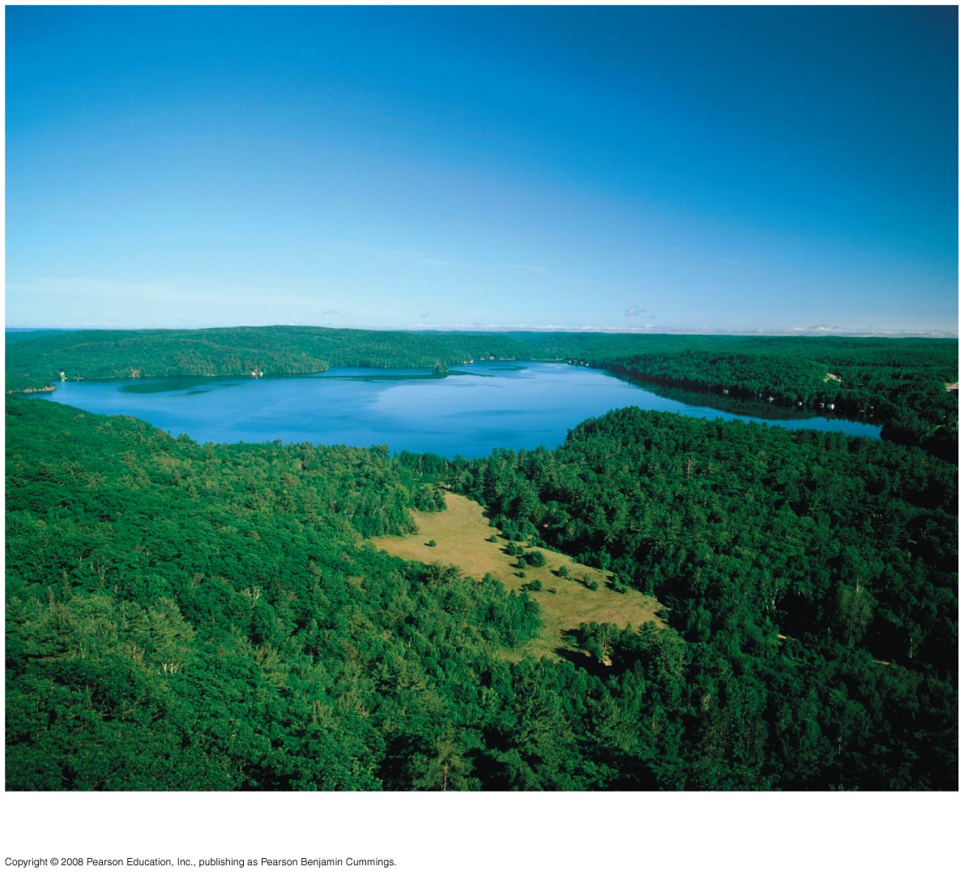
Fig. 1-4d
All living things in a particular area, along with the non-living components of the environment with which life interacts.
Ecosystems

Slide 13
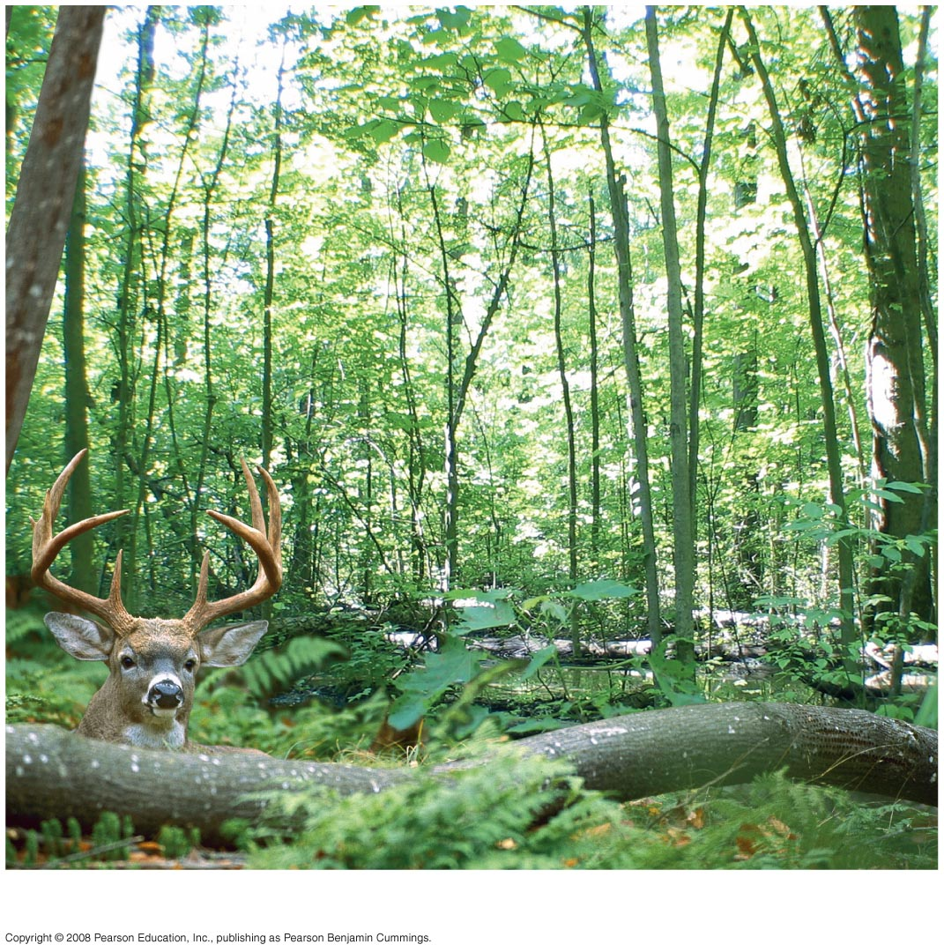
Fig. 1-4e
All the living organisms in a particular ecosystem
Communities

Slide 14
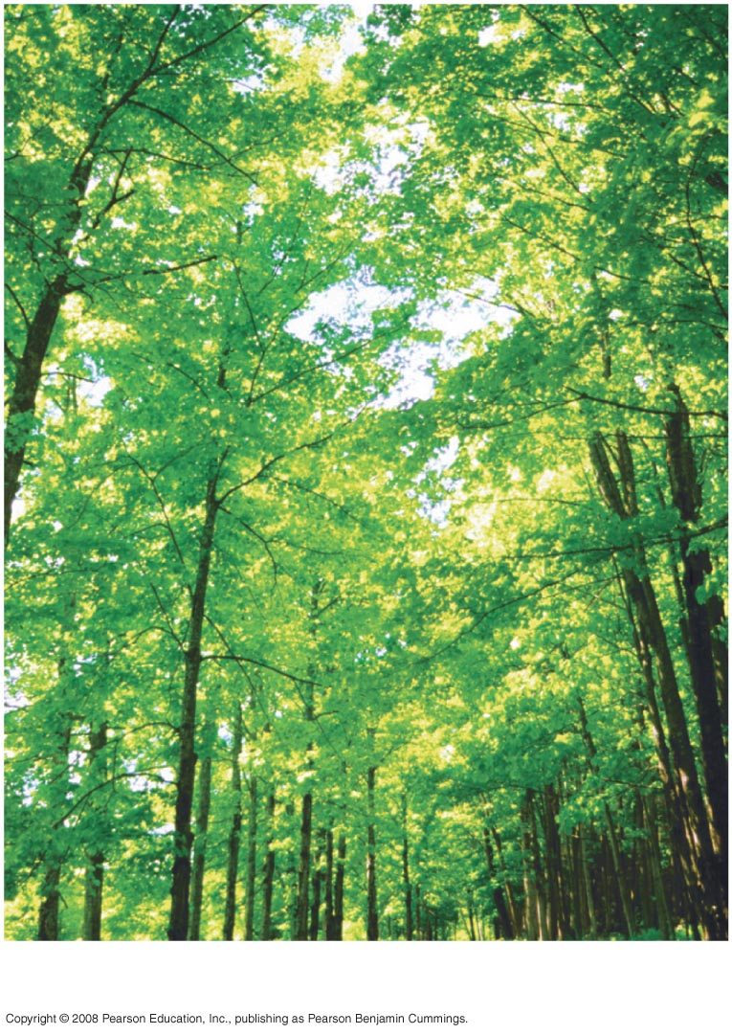
Fig. 1-4f
All the individual members of a species in an given area. Populations combine to form a biological community.
Populations

Slide 15
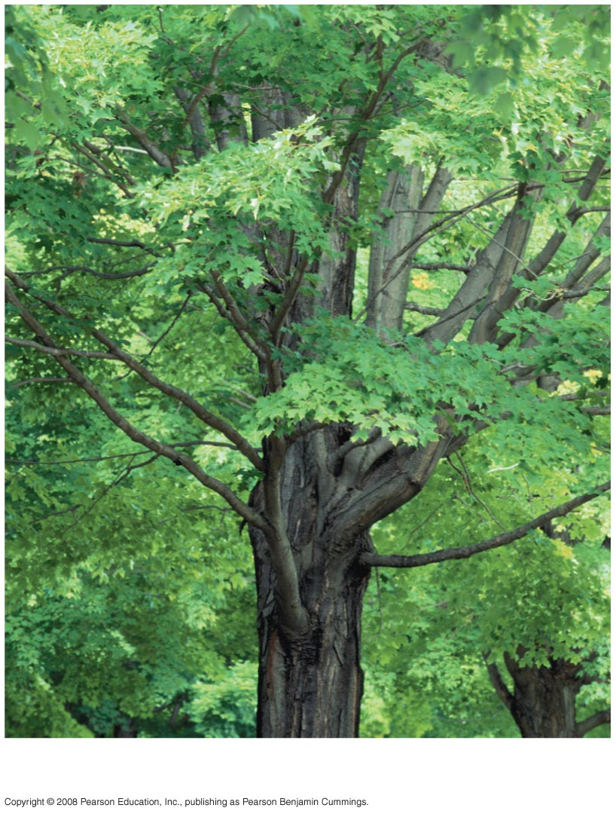
Fig. 1-4g
Individual living things
Organisms

Slide 16
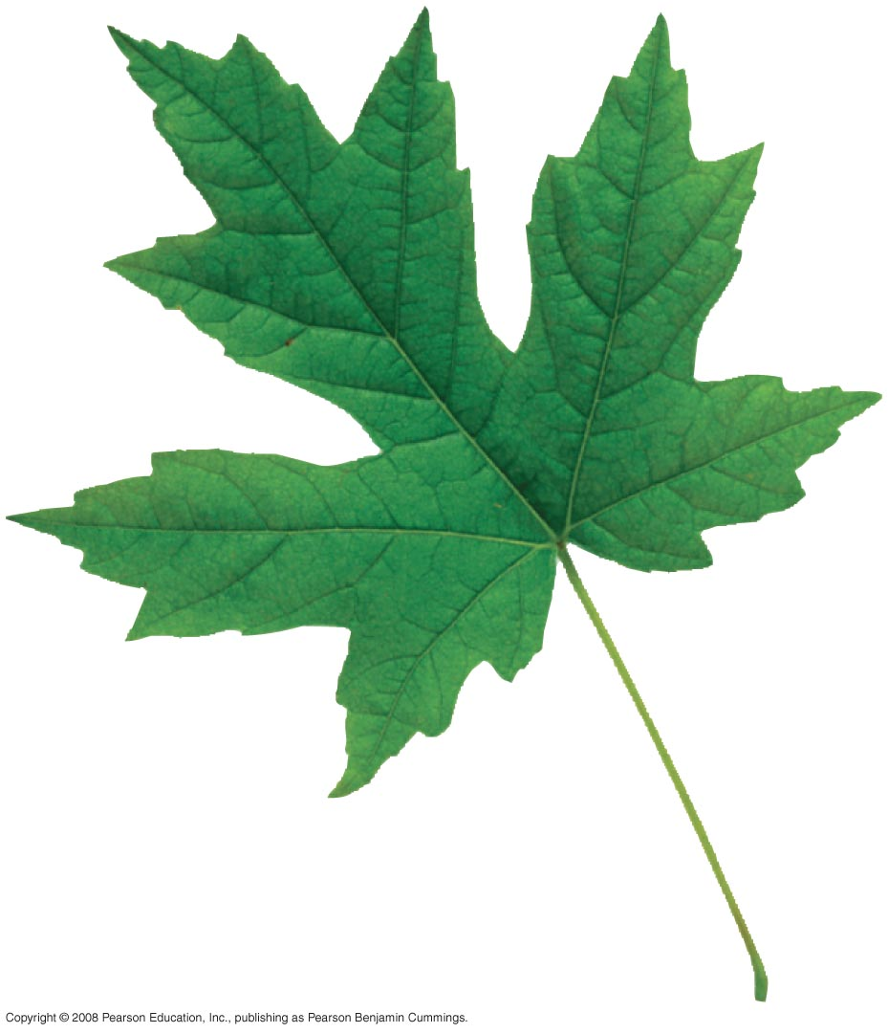
Fig. 1-4h
Organ – body part consisting of two or more tissues.
Organ system – group of organs that cooperate to perform a specific function.
Organs and
organ systems

Slide 17
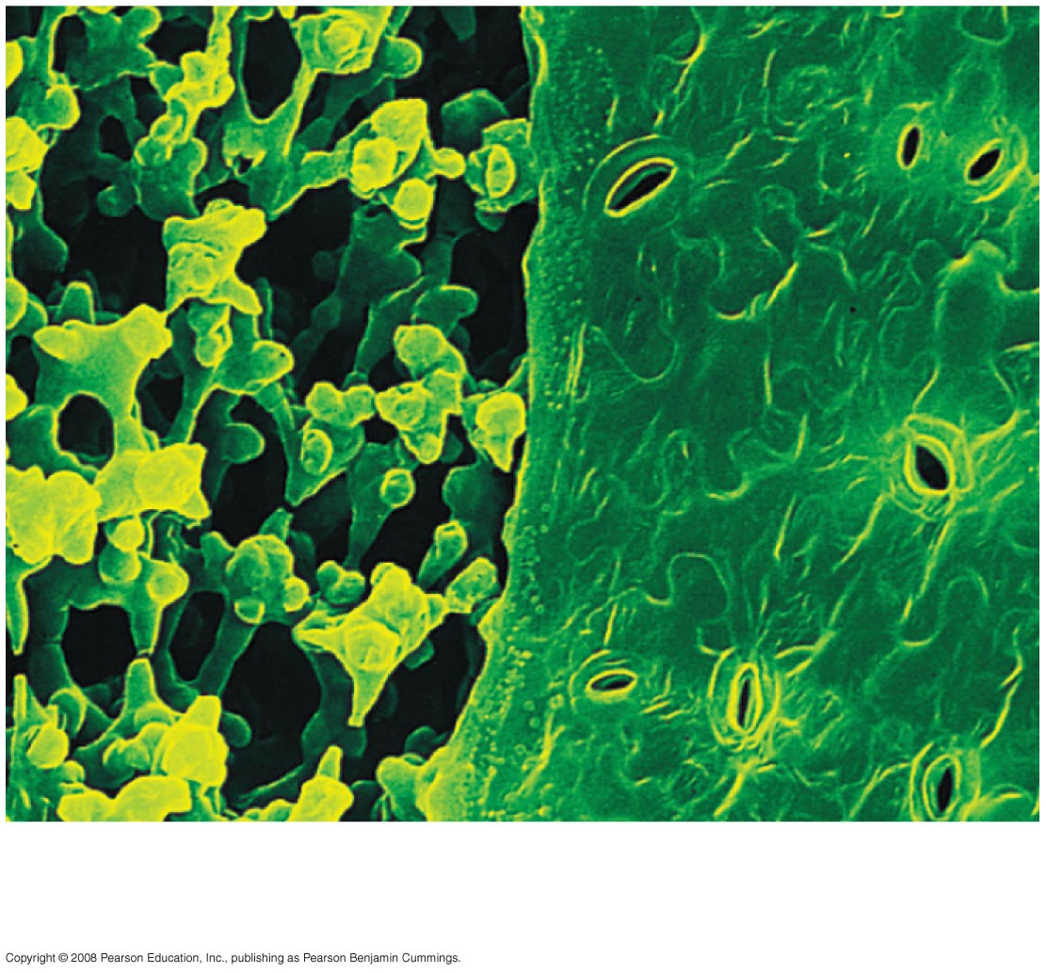
Fig. 1-4i
Groups of cells specialized for a specific function
Tissues
50 µm

Slide 18
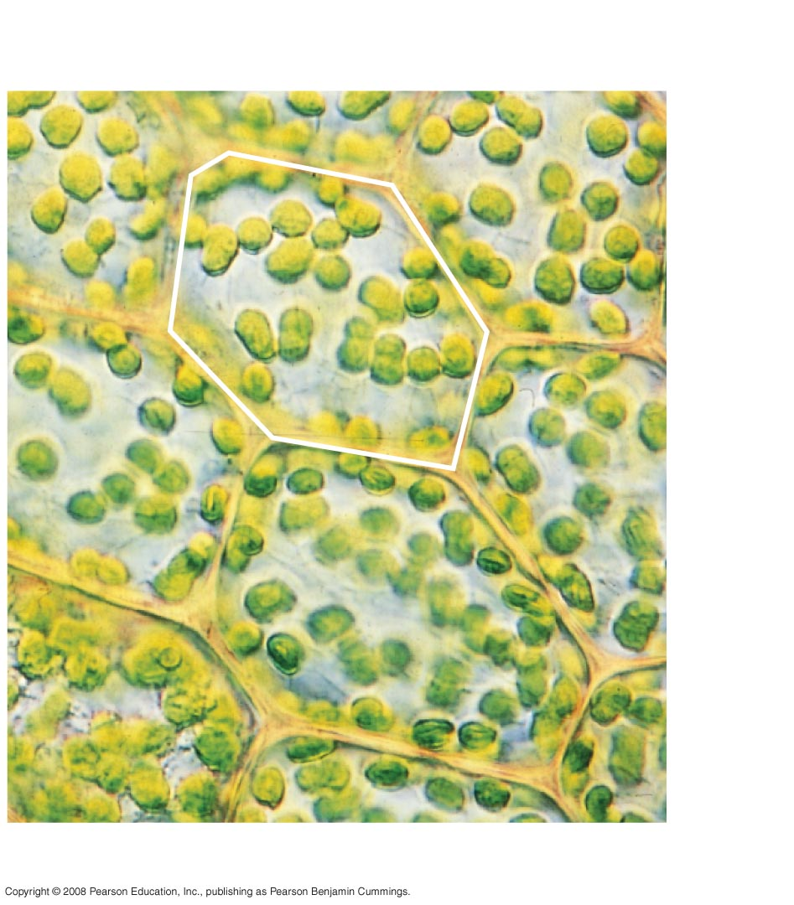
Fig. 1-4j
Life’s fundamental unit of structure and function
Cell
10 µm
Cells

Slide 19
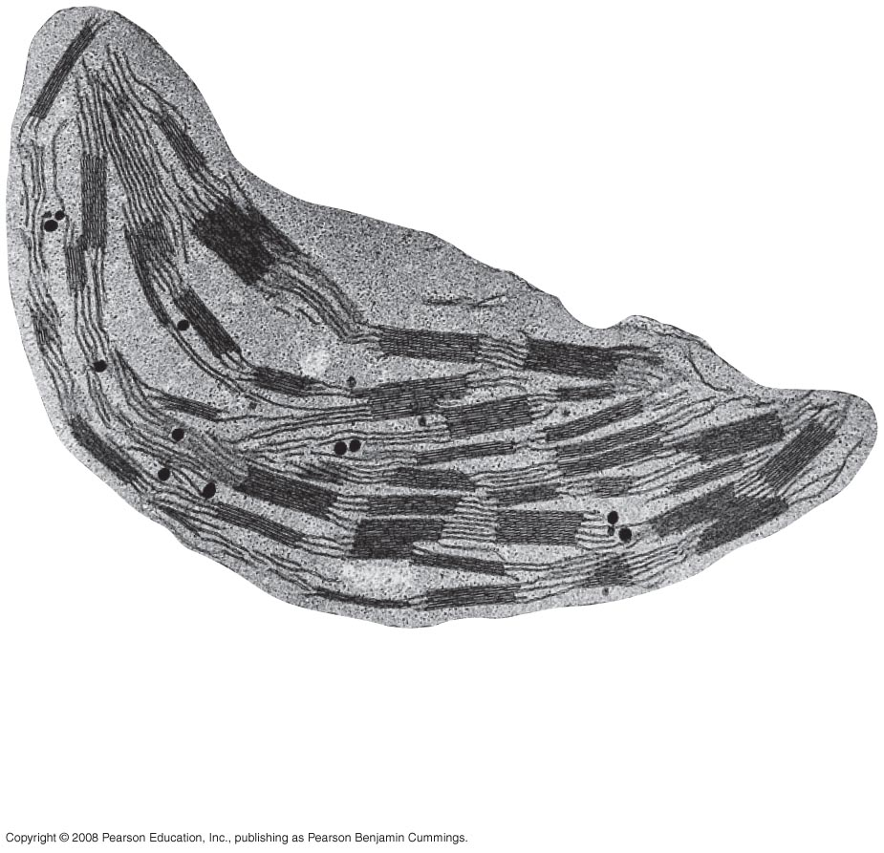
Fig. 1-4k
Various functional components of cells
1 µm
Organelles

Slide 20
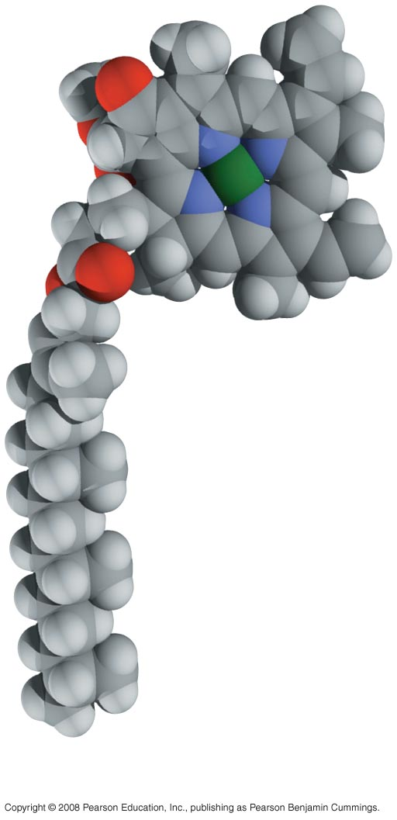
Fig. 1-4l
Chemical structure consisting of two or more small chemical units called atoms.
Atoms
Molecules

Slide 21
Organisms exchange matter and energy
Energy cannot be created or destroyed, but undergoes transformations.
Chemical nutrients cycle through the environment

Slide 22
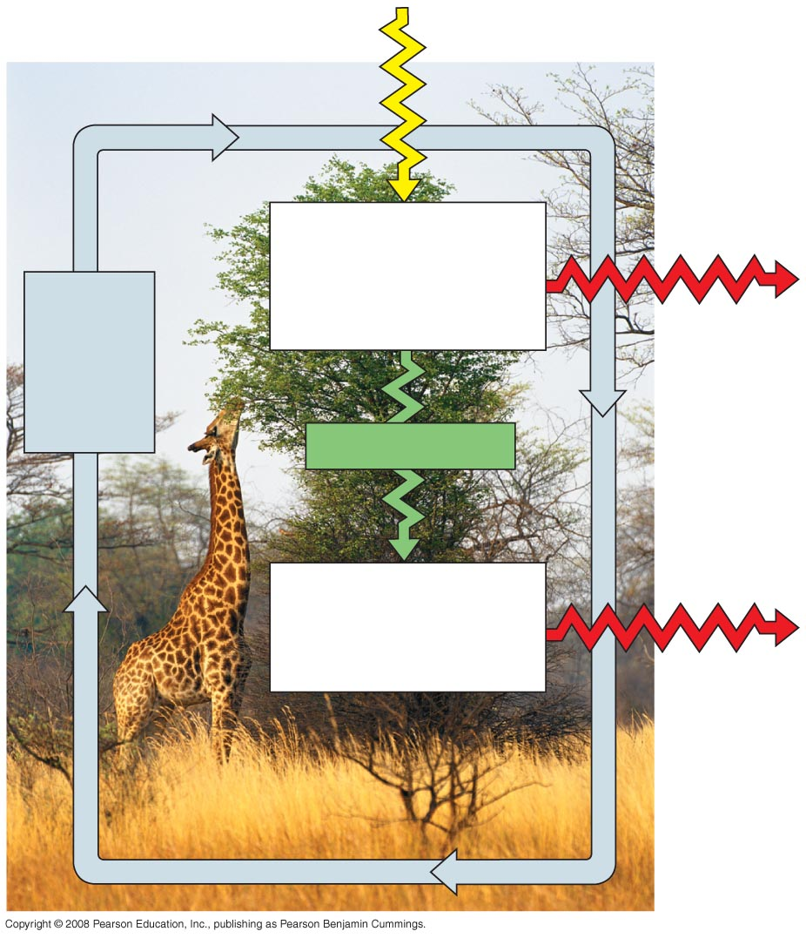
Fig. 1-5
Sunlight
Ecosystem
Producers
(plants and other
photosynthetic organisms)
PppPProducers
(plants and other photosynthetic
organisms)
Cycling
of
chemical
nutrients
Heat
Chemical energy
Consumers
(such as animals)
Consumers
(such as animals)
Heat

Slide 23
Stucture and function are correlated
Biological structure gives clues about what it does and how it works.
The function of something provides insight into its construction.

Slide 24
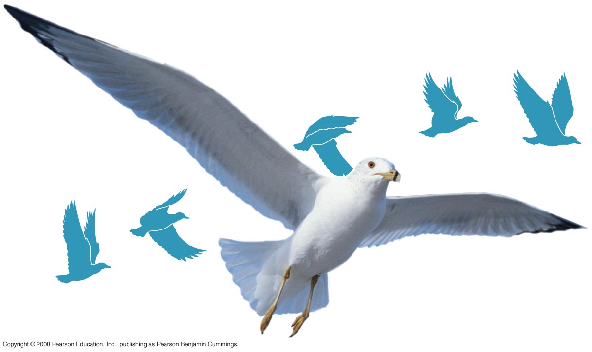
Fig. 1-6a
A bird’s wing is designed for flight.
(
The wing has an aerodynamically efficient shape

Slide 25
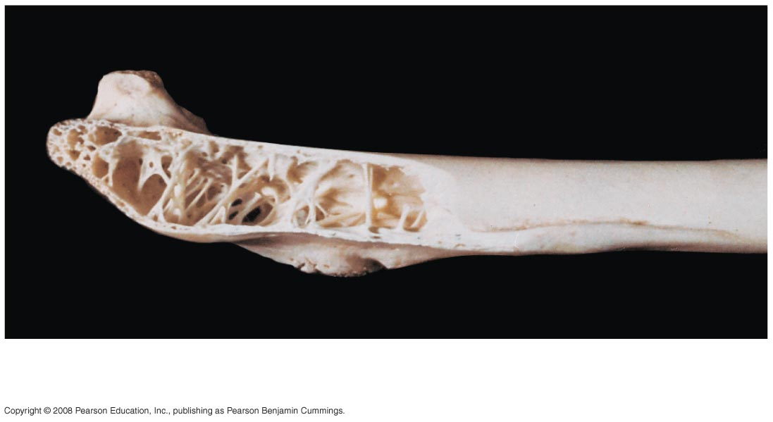
Fig. 1-6b
Wing bones have a honeycombed internal structure that is strong, but lightweight.

Slide 26
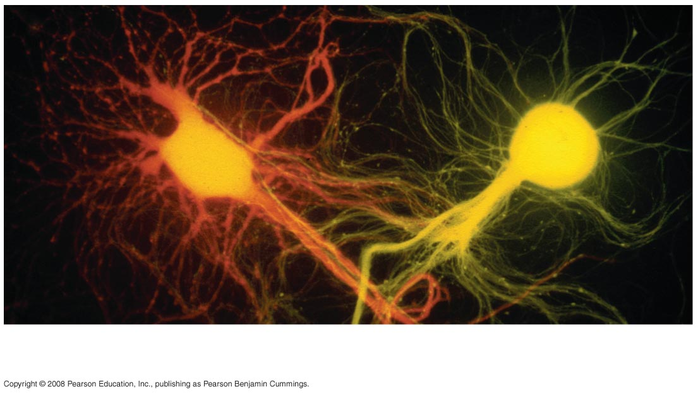
Fig. 1-6c
The flight muscles are controlled by neurons, which transmit signals. Neurons with their many long extensions are designed for communication.
100 µm

Slide 27
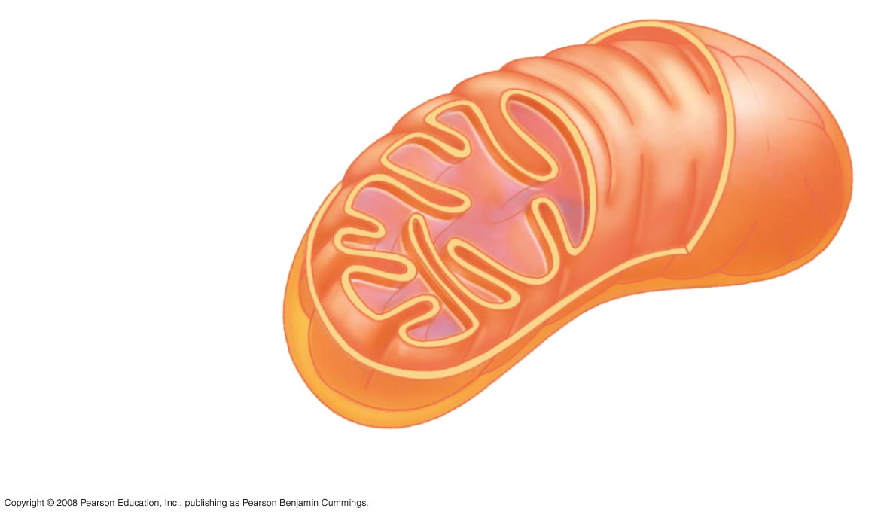
Fig. 1-6d
Flight muscles obtain energy in a usuable form from organelles
called mitochondria. Molecules in the highly folded inner
membrane carry out many of the steps in energy production.
Mitochondrion

Slide 28
Cells are the basic unit of structure and function
There are two types of cells:
Prokaryotes and Eukaryotes

Slide 29
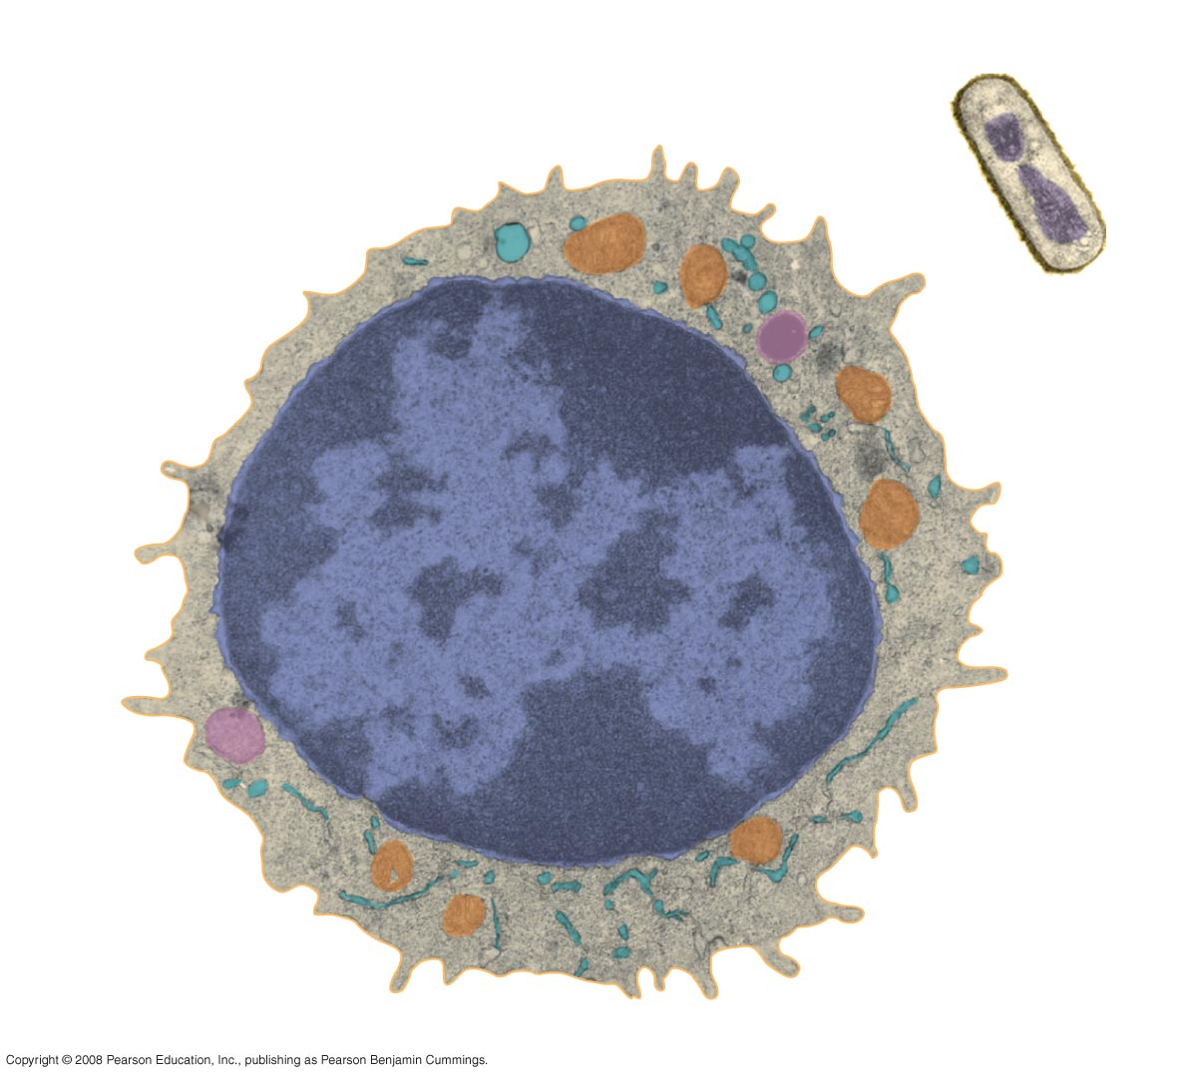
Fig. 1-8
Prokaryotic cell
Eukaryotic cell
Nucleus (Contains DNA)
Membrane
Cytoplasm
Organelles
DNA (no nucleus)
Membrane
Cytoplasm
1 µm

Slide 30
Dna is the substance of genes, the unit of inheritance that transmits information from parents to offspring

Slide 31
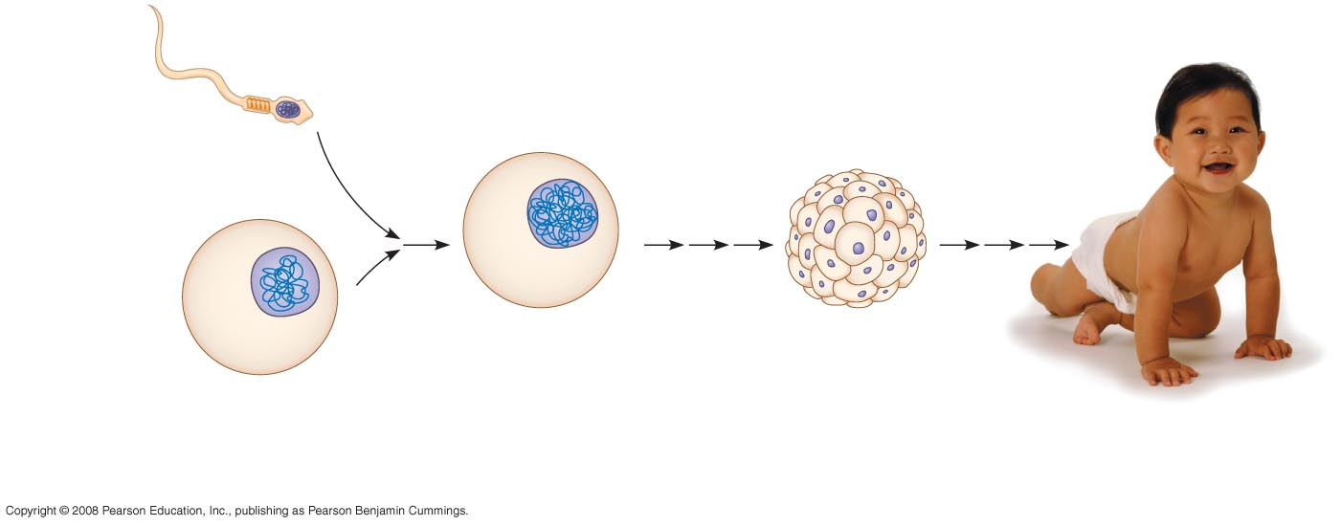
Fig. 1-9
Inherited DNA directs development of an organism.
Nuclei
containing
DNA
Sperm cell
Fertilized egg egg
With DNA from DNA from
both parents
Embryo’s cells with
copies of inherited DNA
Egg cell
Offspring with traits
inherited from
both parents

Slide 32
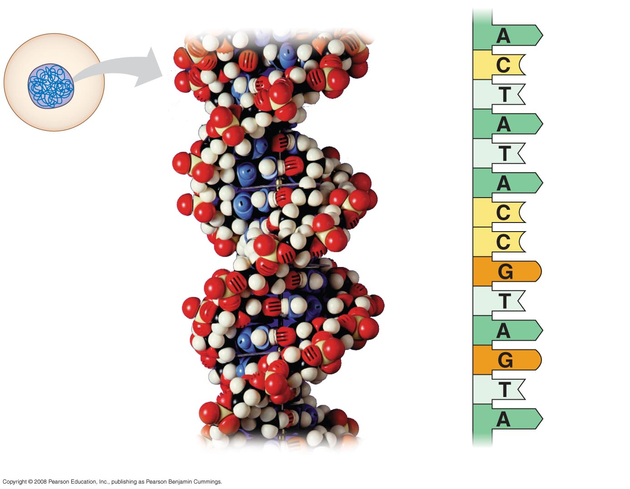
Fig. 1-10
Nucleus
DNA
Nucleotide
Cell
(a) DNA double helix
(b) Single strand of DNA

Slide 33
Feedback mechanisms regulate biological systems
In feedback regulation, the output or product, of a process regulates that process.

Slide 34
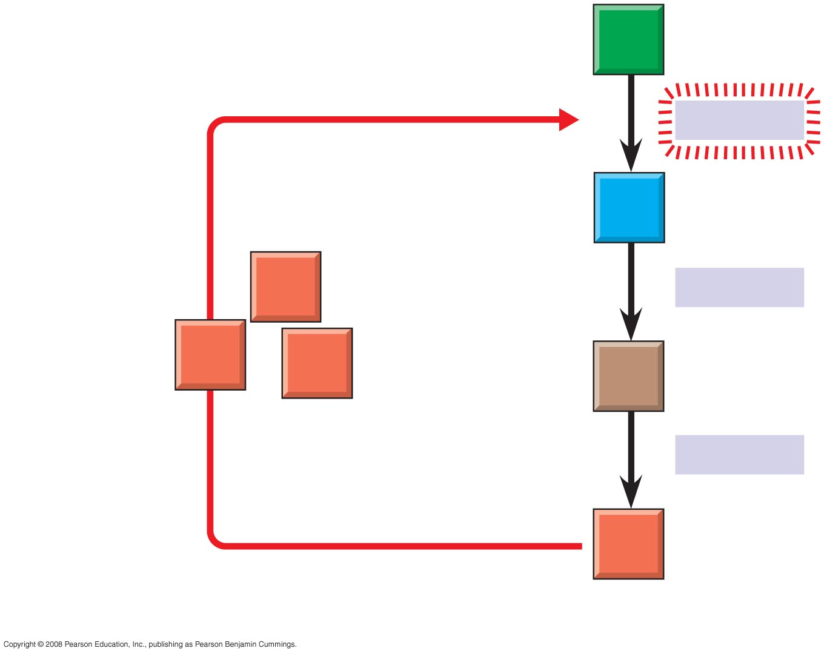
Fig. 1-13a
Negative
feedback
–
A
Enzyme 1
B
D
Enzyme 2
Excess D
blocks a step
D
D
C
Enzyme 3
D
(a) Negative feedback: Accumulation of the final product (D) inhibits the first enzyme in the sequence, slowing down the production of more D.

Slide 35
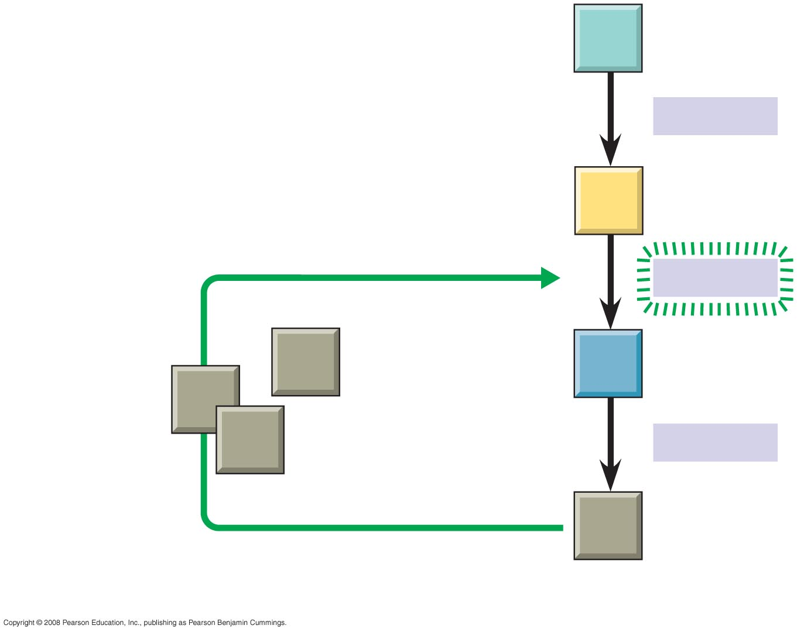
Fig. 1-13b
IIn positive feedback, a product
stimulates an enzyme in the sequence and increases the production of the product.
W
Enzyme 4
X
Positive
feedback
+
Enzyme 5
Excess Z
stimulates a step
Z
Y
Z
Z
Enzyme 6
Z
(b) Positive feedback

Slide 36
Evolution accounts for the unity and diversity of life.
Organizing the Diversity of Life is a major challenge of biologists.

Slide 37
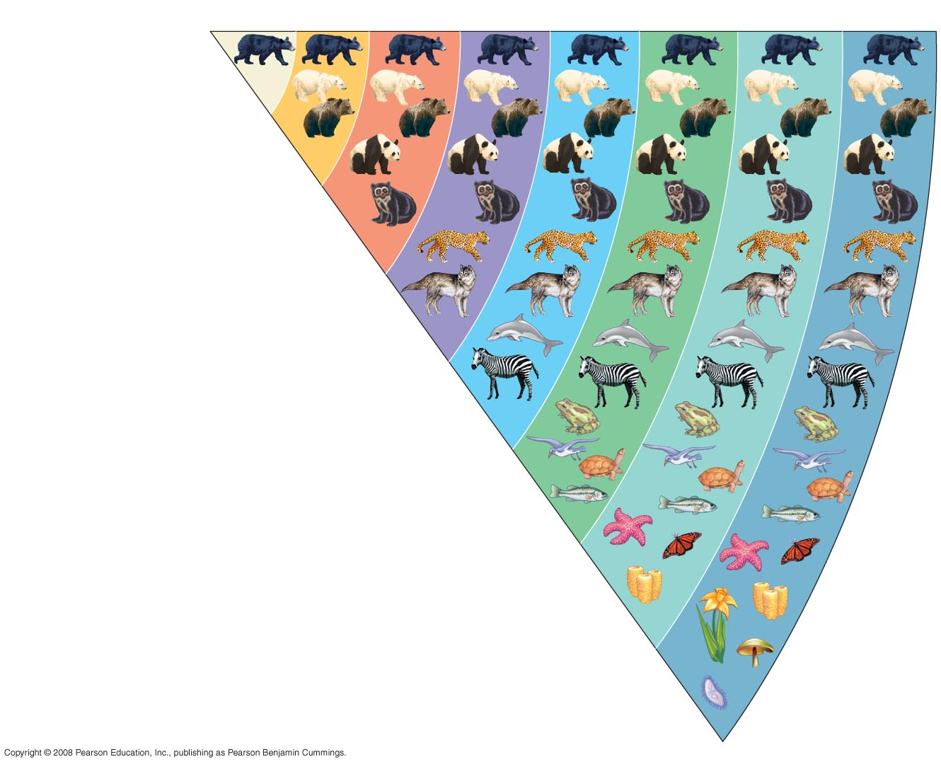
Fig. 1-14
Species
Genus
Family
Order
Class
Phylum
Kingdom
Domain
Ursus americanus
(American black bear)
Ursus
Ursidae
Carnivora
aBiologists classify species into groups that are then combined into even broader groups, for example groups of similar species are grouped into a genus, groups of similar genera are grouped into a family, families into orders, etc.
Mammalia
Chordata
Animalia
Eukarya

Slide 38
There are three domains of life.
Domains are large groups made up of kingdoms. They are a relatively new classification.
The three domains are:
Domain Bacteria
Domain Archaea
Domain Eukarya

Slide 39
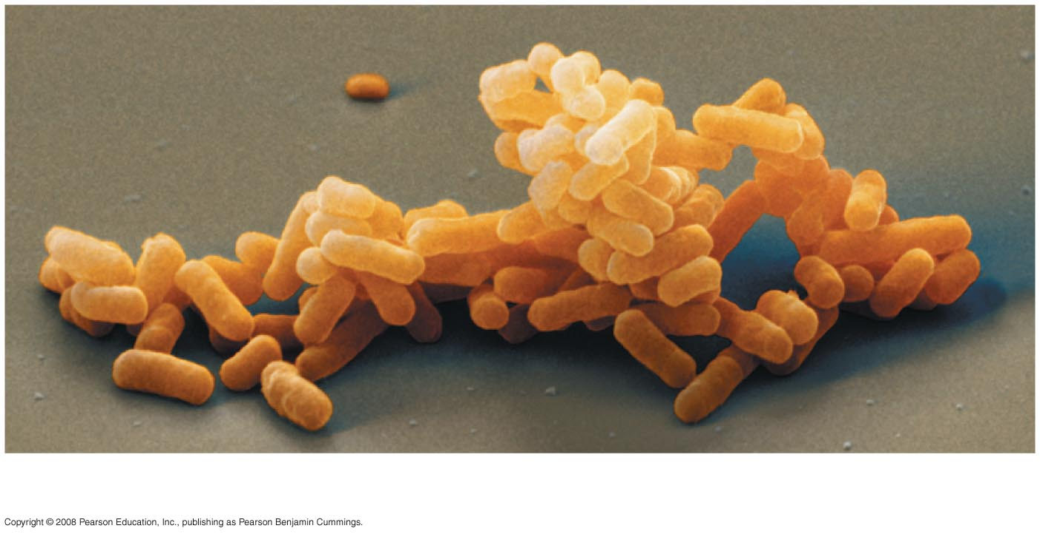
Fig. 1-15a
Domain Bacteria are the most diverse and widespread prokaryotes.
(a) DOMAIN BACTERIA

Slide 40
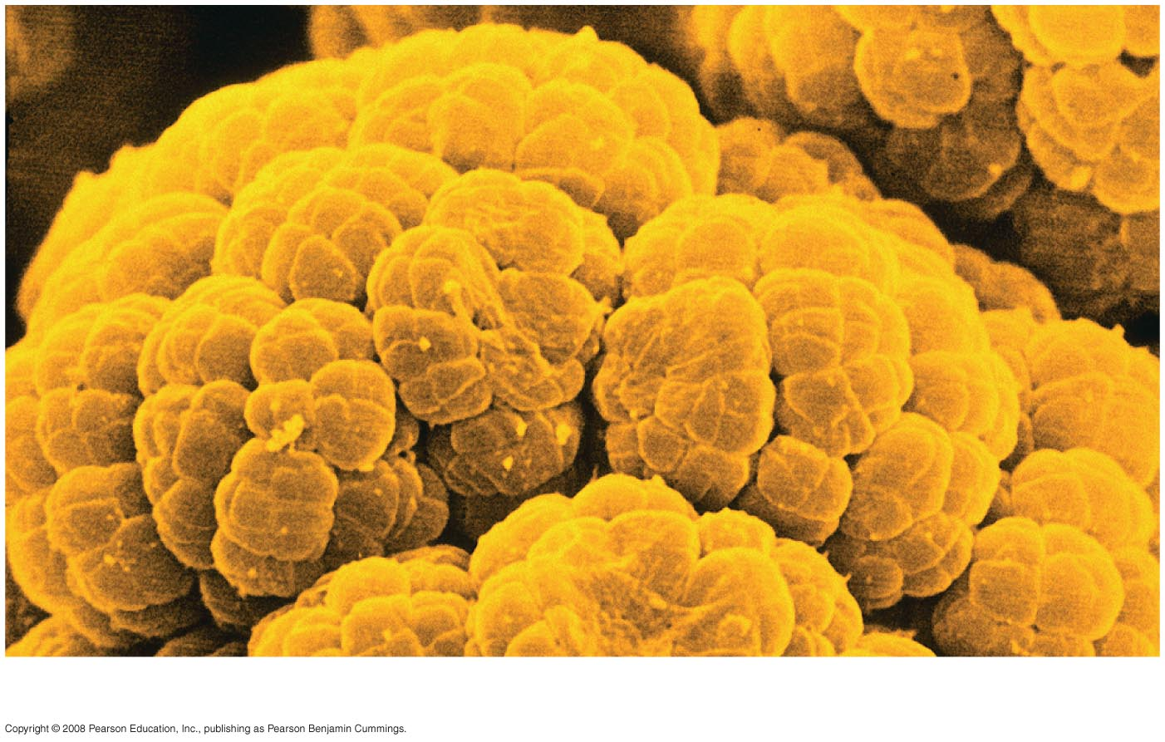
Fig. 1-15b
Domain Archaea live in extreme environments, such as salty lakes and boiling hot springs.

Slide 41
The Domain Eukarya
Contains all organisms with cells having a nucleus and membrane bound organelles
There are multiple kingdoms in the Domain Eukarya

Slide 42
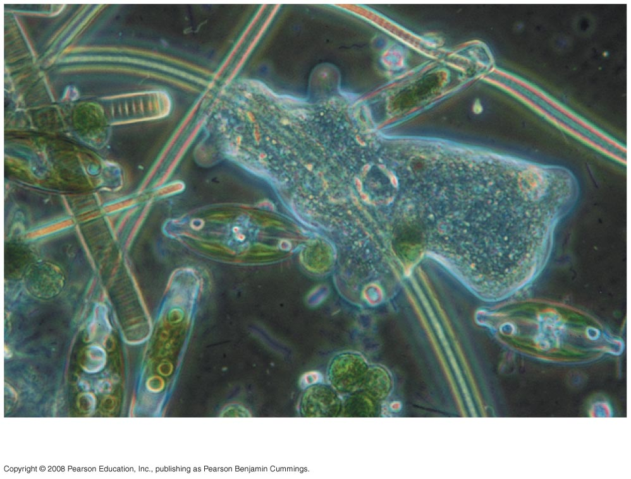
Fig. 1-15d
Protists contain multiple kingdoms, but are mostly unicellular
eukaryotes. They had previously been one of the five kingdoms
of Eukarya, but are in the process of reclassification
Protists

Slide 43
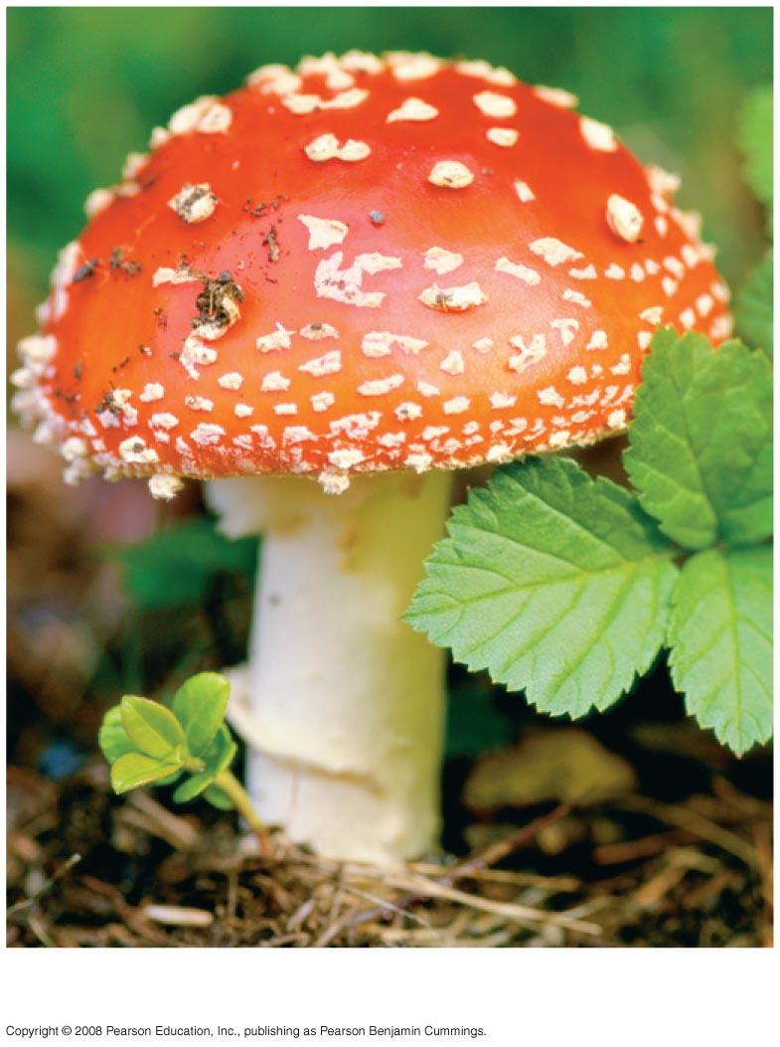
Fig. 1-15e
Kingdom Fungi is a multicellular kingdom defined mainly by its mode of nutrition. Fungi absorb nutrients from their environment.
Kingdom Fungi

Slide 44
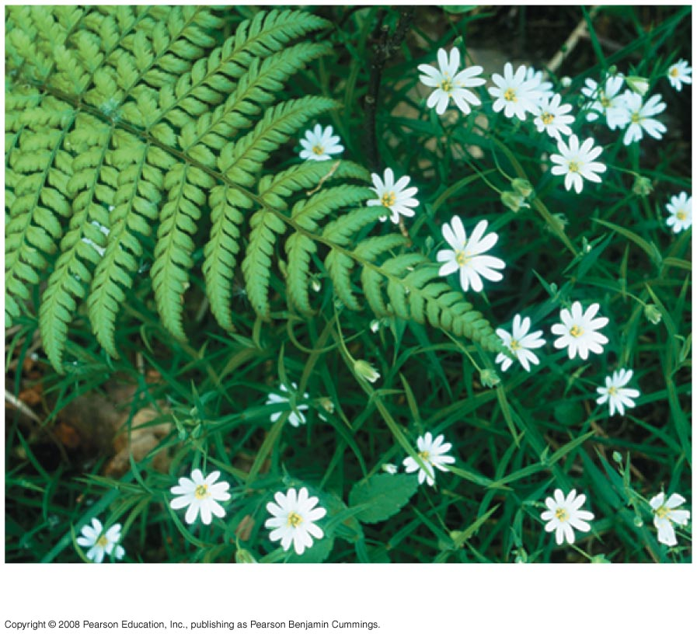
Fig. 1-15f
Kingdom Plantae consists of multicellular eukaryotes that carry out photosynthesis.
Kingdom Plantae

Slide 45
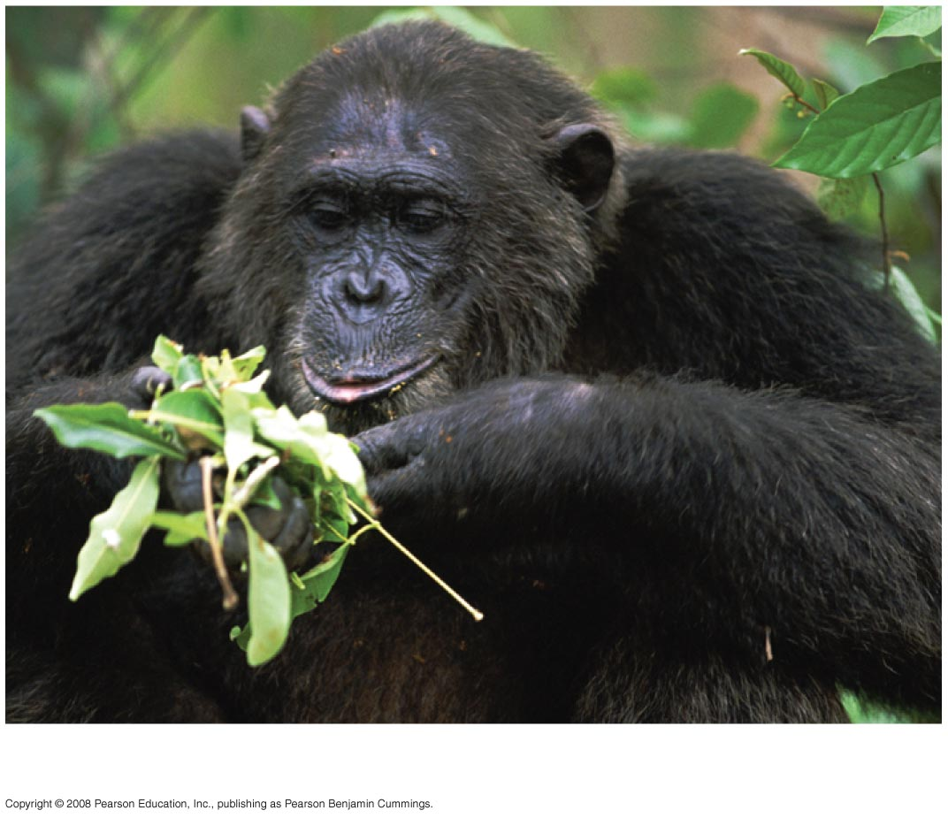
Fig. 1-15g
Kindom Animalia consists of multicellular eukaryotes that
injest other organisms.
Kingdom Animalia

Slide 46
Charles darwin and the theory of natural selection
“Descent with modification”
There is unity among species that descended from a common ancestor;
diversity in the modifications that evolved as species branched from their common ancestor.

Slide 47
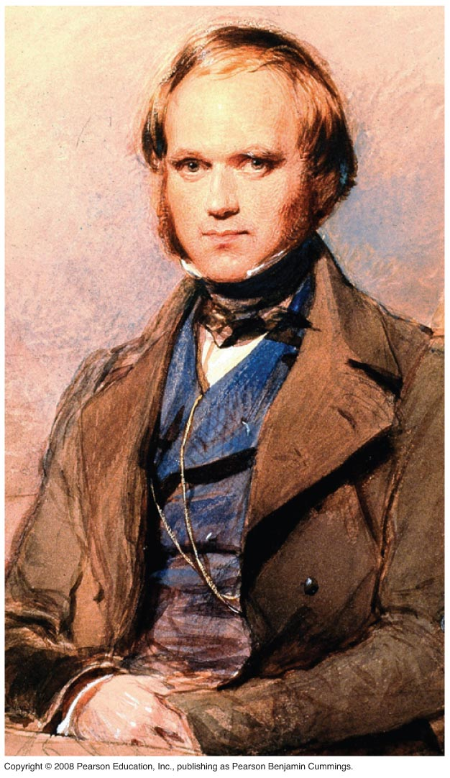
Fig. 1-18

Slide 48
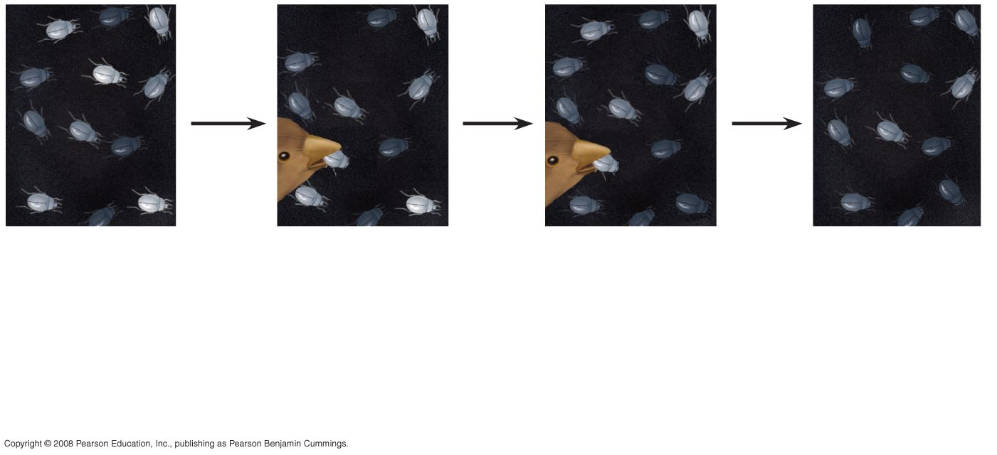
Fig. 1-20
Steps that lead to change in a population.
1
2
3
4
Elimination
of individuals
with certain
traits.
Increasing
frequency
of traits that enhance survival and reproductive success.
Population
with varied
inherited traits.
Reproduction
of survivors.

Slide 49
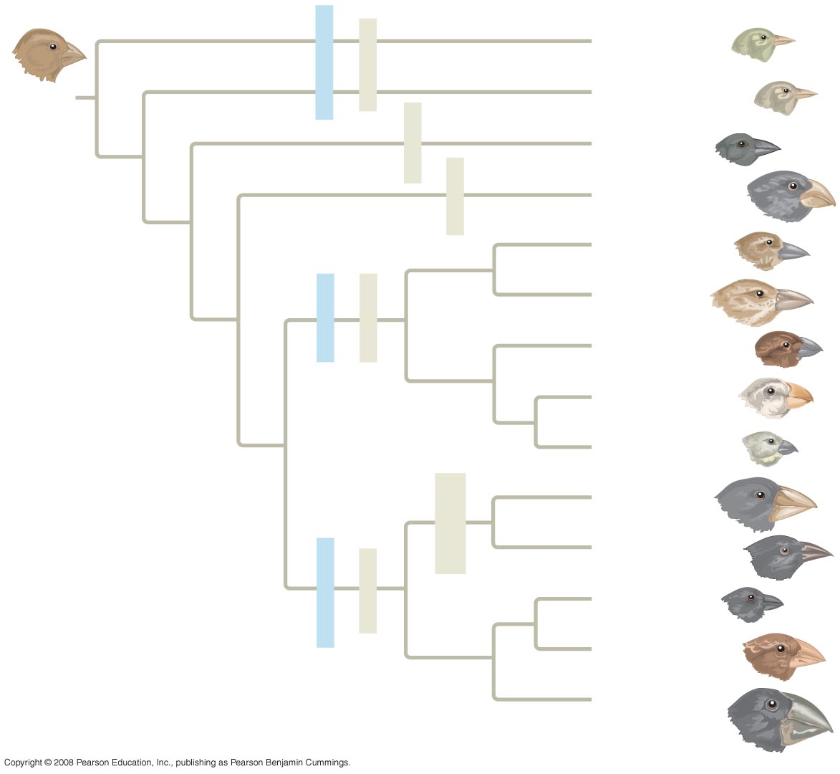
Fig. 1-22
Green warbler finch Certhidea olivacea
Warbler finches
Insect-eaters
COMMON
ANCESTOR
Gray warbler finch Certhidea fusca
Seed-eater
Sharp-beaked
ground finch Geospiza difficilis
Bud-eater
Vegetarian finch Platyspiza crassirostris
Mangrove finch Cactospiza heliobates
Woodpecker finch Cactospiza pallida
Tree finches
Insect-eaters
Medium tree finch Camarhynchus pauper
Large tree finch Camarhynchus psittacula
Small tree finch Camarhynchus parvulus
Large cactus
ground finch
Geospiza conirostris
Cactus-flower-eaters
Cactus ground finch
Geospiza scandens
Seed-eaters
Ground finches
Small ground finch
Geospiza fuliginosa
Medium ground finch
Geospiza fortis
Large ground finch
Geospiza magnirostris

Slide 50
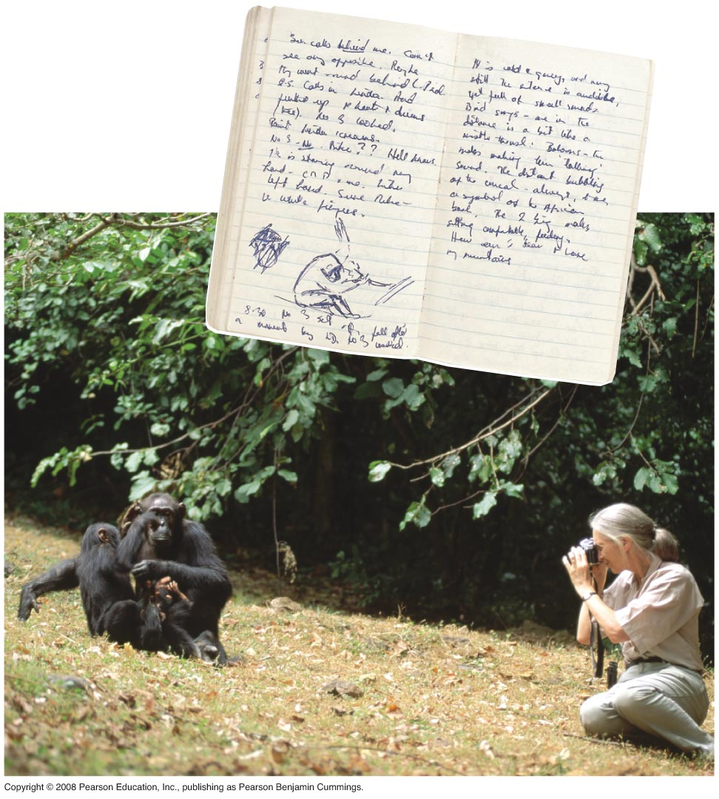
Fig. 1-23
Methods of Science
Qualitative Methods
Jane Goodall and chimpanzees

