Slide 1
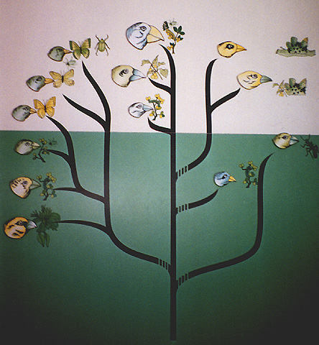
The Origin of Species

Slide 2
Speciation is the process by which new species arise.

Slide 3
Microevolution is a change in the genetic makeup of a population from generation to generation.
Refers to adaptations that are confined to a single gene pool and change gene frequency.
Results of natural selection, genetic drift, and gene flow.

Slide 4
Macroevolution refers to evolutionary change above the species level.
Mechanisms by which new species develop from previous species.
Example: The development of feathers resulting in higher taxa.

Slide 5
Biological Species
A population or group of populations whose members have the potential to interbreed in nature and produce viable, fertile offspring, but are unable to produce viable, fertile offspring with members of other populations.

Slide 6
The biological species concept emphasizes reproductive isolation.
Biological barriers prevent members from two species from producing viable, fertile offspring.
Two types of barriers are prezygotic
and postzygotic barriers.

Slide 7
Prezygotic barriers impede mating or prevent fertilization if mating does occur. Types of Prezygotic Barriers:
Habitat Isolation
Behavioral Isolation
Temporal Isolation
Mechanical Isolation
Gametic Isolation

Slide 8
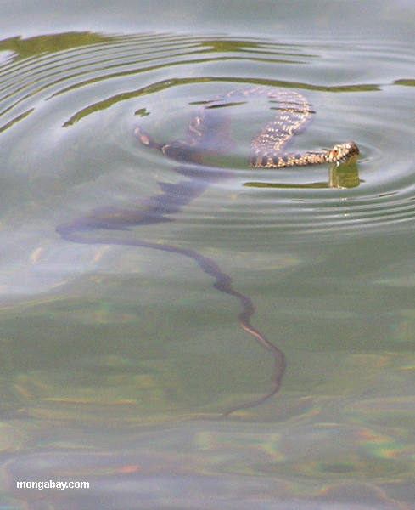
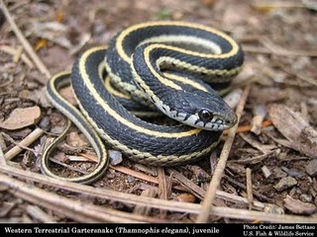
Prezygotic Barriers
Habitat isolation
Two species that occupy the same area may never encounter each other.
Example: Two species of garter snakes occupy same geographic area, but one is terrestrial and one is aquatic.

Slide 9
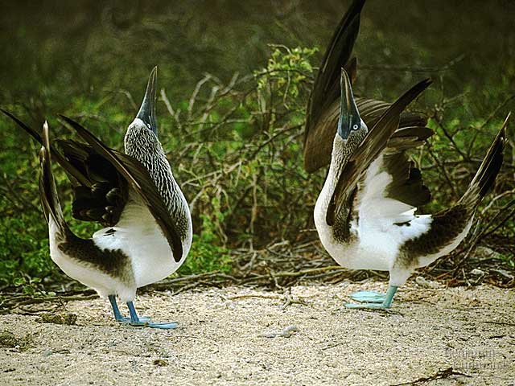
Prezygotic Barriers
Behavioral Isolation results when some species use certain signals to attract a mate and those signals are unique so that other species do not respond to those signals.

Slide 10
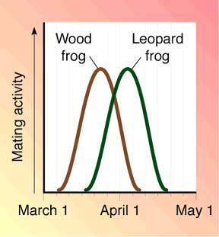
Prezygotic Barriers
Temporal Isolation
Species may breed at different times of day, different seasons, or different years, which may prevent them from dating.

Slide 11
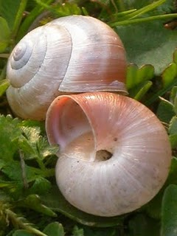
Prezygotic Barriers
Mechanical Isolation
Species may be anatomically incompatible.
Shells spiral in
opposite direction so
that genital openings
do not line up.

Slide 12
Prezygotic Barriers
Gametic Isolation:
Even if the gametes of two species do meet, they might be unable to fuse to form a zygote.
Example: proteins on surface of sperm must match proteins on surface of egg.

Slide 13
Post zygotic Barriers prevent a fertilized egg from developing into a fertile adult. Types of Postzygotic Barriers:
Reduced Hybrid Viability
Reduced Hybrid Fertility
Hybrid Breakdown

Slide 14
Postzygotic Barriers
Reduced Hybrid Viability
The genes of different parent species may interact in a way that impairs the development of the hybrid so that it does not survive.
Usually do not complete development and those that do are frail.

Slide 15
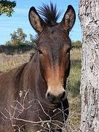
Postzygotic Barriers
Reduced Hybrid Fertility
Hybrids are vigorous, but are sterile.
Chromosome number of two species differ in number of structure and meiosis fails to produce gametes that can mate with either parent species.

Slide 16
Postzygotic Barriers
Hybrid Breakdown
Some first generation hybrids are viable and fertile, but when hybrids mate, the offspring of the next generation are feeble or sterile.

Slide 17
Speciation can take place with or without geographic isolation.
Allopatric Speciation:
A population forms a new species because it is geographically isolated form the parent population.
Emergence of a mountain range
Formation of a land bridge
Evaporation of a large lake into several smaller lakes

Slide 18
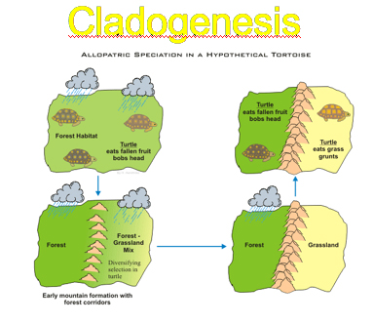

Slide 19
Allopatric Speciation is confirmed when individuals from the new population are unable to mate with the individuals from the parent population.

Slide 20
Sympatric Speciation
A small part of a population becomes a new population without being geographically separated.
Mechanisms leading to sympatric speciation:
Formation of autopolyploids
Allopolyploidy
Habitat Selection
Sexual Selection

Slide 21
Formation of Autopolyploids
Nondisjunction during meiosis results in organisms with extra sets of chromosomes.
Example: plants may have a 4n chromosome number, instead of normal 2n and cannot breed with diploid plants and produce fertile offspring.

Slide 22
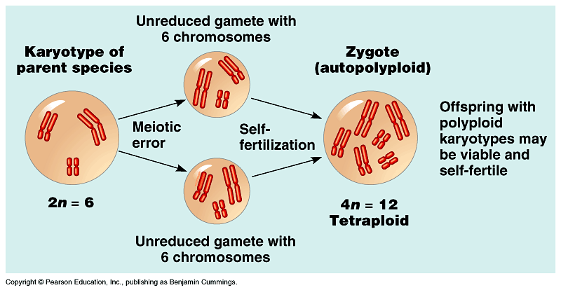

Slide 23
Allopolyploidy
Members of different species with different numbers of chromosomes mate and produce hybrid offspring that are infertile because they have different chromosome numbers that either parent species.
Sometimes the infertile hybrids can reproduce asexually and overtime may change into a fertile polyploid that can mate with other polyploids, but still not either parent species, therefore is a new species.

Slide 24
Many plants are polyploid including many of our most important agricultural crops.
Oats
Cotton
Potatoes
Cotton
Wheat

Slide 25
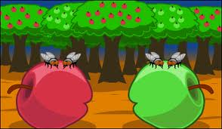
Habitat Selection:
In occupying different parts of the same habitat, become adapted to that environment and eventually exclusive to it. Could mate, but don’t.

Slide 26
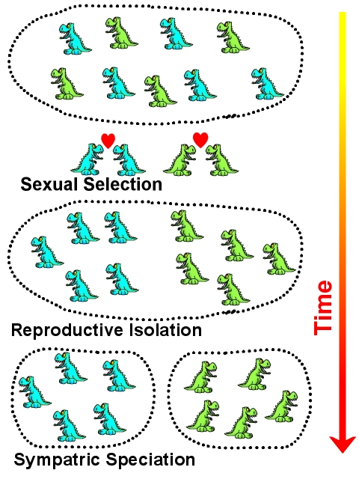
Sexual Selection
Mate selection
based on male
breeding coloration
can be a reproductive
barrier that can result in
keeping gene pools
separate.

Slide 27
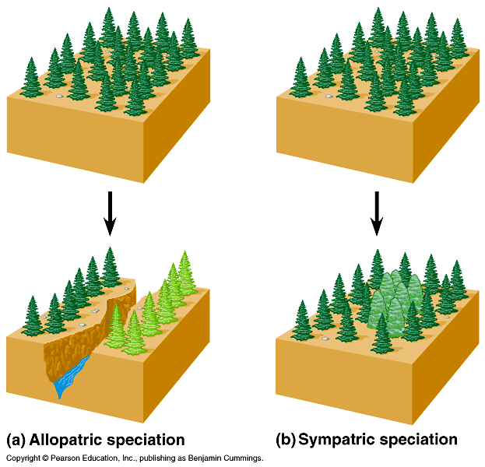

Slide 28
Adaptive Radiation
Many new species arise from a single common ancestor.
Typically occurs when a few organisms make their way to new, distant areas or when environmental condition change causing numerous extinctions, opening up ecological niches for the survivors.

Slide 29
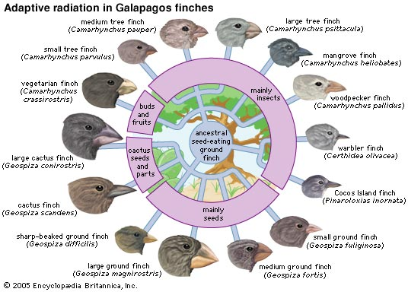

Slide 30
Speciation can occur rapidly or slowly, and it can result from changes in few or many genes.
Gradualism: Species descend from a common ancestor and gradually diverge more and more as they acquire unique adaptations.
Punctuated Equilibrium: There are periods of apparent little change punctuated by periods of rapid change observed in the fossil record.

Slide 31
