Slide 1
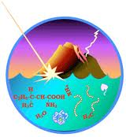
The history of life on earth

Slide 2
Conditions on early Earth made the Origin of Life possible.
Current theory about how life on Earth began.
Earth formed about 4.6 billion years ago.
Earth was too hot and still being bombarded by meteors, any water evaporated.
Planet gradually cooled and seas formed.
Many volcanic eruptions.
Atmosphere contained nitrogen, carbon dioxide, methane, ammonia, hydrogen, and hydrogen sulfide. (Most hydrogen escaped into space)

Slide 3
Life Arose in Four Main Stages
Small organic molecules were synthesized.
These small molecules joined into macromolecules, such as proteins and nucleic acids.
All these molecules were packaged into protobionts (membranes containing droplets, whose chemical makeup differed from the external environment).
Self-replicating molecules emerged that made inheritance possible.

Slide 4
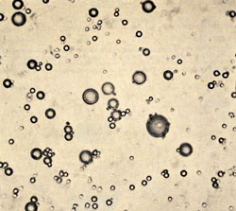
Protobionts
Experiments show that protobionts could have formed spontaneously from abiotically produced organic compounds present on early earth.

Slide 5
Ribozymes
The first genetic material was most likely RNA, not DNA.
Single-standed RNA can base pair with itself in many different forms.
Some forms can function as enzymes that can then catalyze the replication of the RNA molecule.
Better RNA molecules (those that are more stabile or can replicate faster) are then selected for.

Slide 6
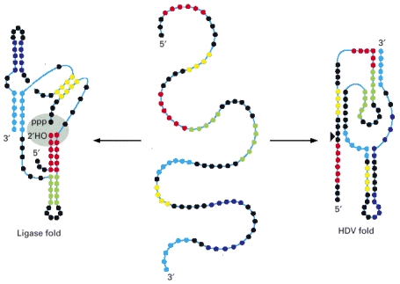

Slide 7
Life on Earth emerged about 3.8 to 3.9 billion years ago. For the first three-quarters of Earth’s history, that life was microscopic and unicellular.

Slide 8
Hypothetical early conditions on Earth have been simulated in the laboratory and organic molecules have been produced.
Oparin and Haldane
Miller and Urey

Slide 9
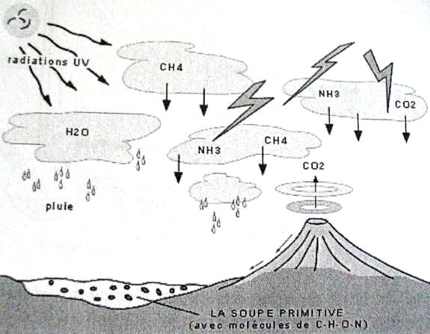
Oparin and Haldane
Hypothesized that the early atmosphere, thich with water vapor, nitrogen, carbon dioxide, methane, ammonia, hydrogen, and hydrogen sulfide, provided with energy from lightning and UV radiation, could have formed organic
compounds.
The “primordial soup”

Slide 10
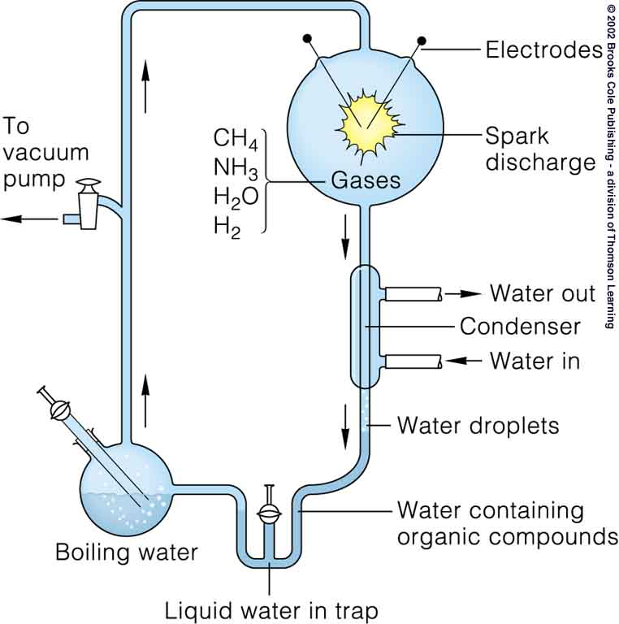
Miller and Urey
Tested Oparin and Haldane’s theory and produced a variety of amino acids.

Slide 11
Fossil Record Documents the history of life on Earth.
Fossil record is the sequence in which fossils occur in undisturbed sedimentary rock.
Fossil record is imcomplete because most fossils are remains of organisms with hard shells or bony skeleton.

Slide 12
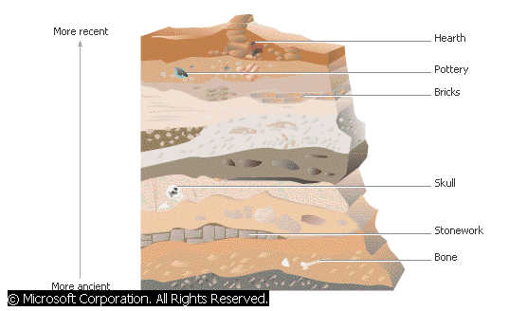
Relative Dating
Uses the strata of rocks to determine relative age of fossils.

Slide 13
Radiometric Dating
Uses the decay of radioactive isotopes to determine the age of rocks or fossils.
It is based on the rate of decay or half-life of the isotope.

Slide 14
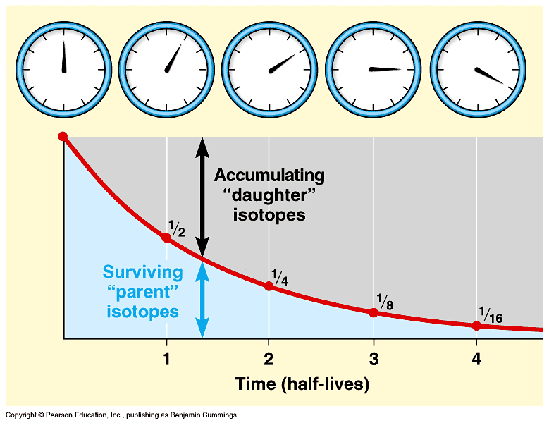

Slide 15
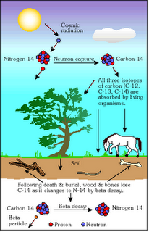
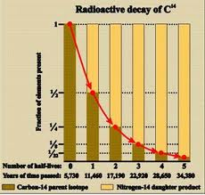

Slide 16
Key Events in Life’s History
Earliest living organisms were prokaryotes.
About 2.7 billion years age, oxygen began to accumulate in the Earth’s atmosphere do to development of photosynthetic organisms.
First Eukaryotes appeared about 2.1 billion years ago.

Slide 17
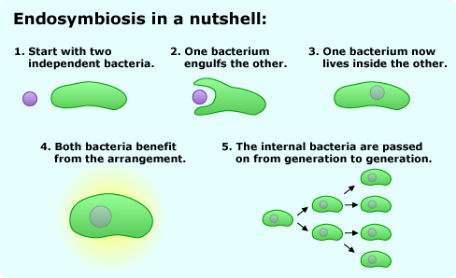
Endosymbiotic Theory
Proposes that mitochondria and plastids (chloroplasts) were formally small prokaryotes that began living symbiotically within larger cells.

Slide 18
Evidence for the Endosymbiotic Theory
Both organelles have enzymes and transport systems homologous to those found in the plasma membrane of living prokaryotes.
Both replicate by a splitting process called fission.
Both contain a single, circular DNA molecule not associated with proteins, as in eukaryotes.
Both have their own ribosomes which are different from eukaryotic ribosomes

Slide 19
Multicellular Eukaryotes evolved 1.2 billion years ago. The coloniztion of land occurred about 500 million years ago, when plants, fungi and animals began to appear on Earth.

Slide 20
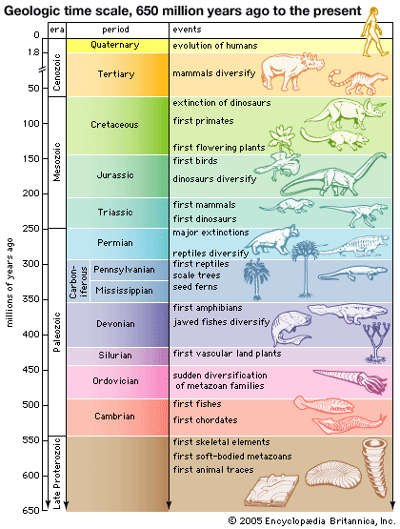

Slide 21
Rise and Fall of dominant groups reflect the action of continental drift, mass extinctions, and adaptive radiations.
Continental Drift: movement of the Earth’s great plates that float on the hot underlying mantle.
Mass Extinction: loss of large number of species in a short period of time.
Adaptive Radiations: periods of evolutionary change in which groups of organisms form many new species whose adaptations allow them to fill different ecological niches.

Slide 22
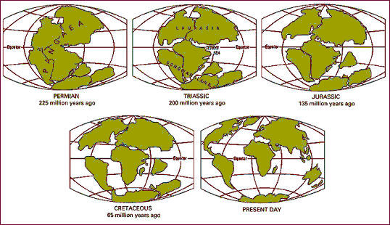
Continental Drift
Alters habitat and promotes allopatric speciation.
Explains disjunct geographic distribution of certain species.
Explains why no placental mammals are indigenous to Austrailia.

Slide 23
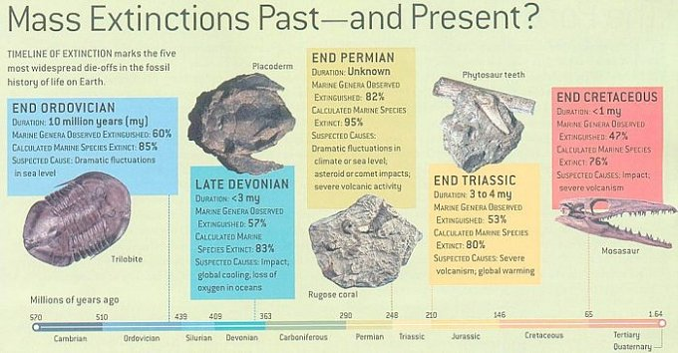
Mass Extinction
Result of global environmental changes that have caused the rate of extinction to increase dramatically.

Slide 24
Worldwide Adaptive Radiations
Followed each of the major mass extinctions as survivors became adapted to many vacant ecological niches.
Also occurs in organisms that have major evolutionary adaptations, such as seeds or armored body coverings, or that colonized regions in which they faced little or no competition.

Slide 26
Evolution in not goal oriented.
New forms, including novel and complex structures can develop from slight modification of existing forms.
Question: The human eye is very complex and requires many interacting parts in order to form an image and transmit it to the brain. How could it have evolved in small steps?

Slide 27
Simple eyes in other animals perform same function.
Simplest eyes are patches of light-sensitive cells that cannot focus image, but only distinguish between light and dark.
Simple eyes appear to have a single evolutionary origin.
Complex eyes have evolved from simple eyes many times.

Slide 28
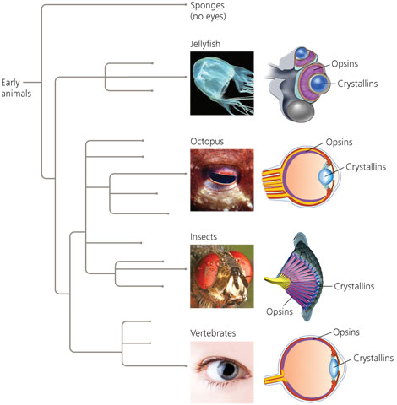

Slide 29
Exaptations
Structures that evolve in one context and become co-opted for another function.
Example: In the ancestors of early mammals, bones that had formerly been part of the jaw hinge became incorporated into the ear region and gained a new function of transmission of sound.

Slide 30
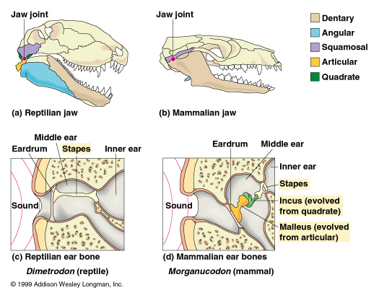

Slide 31
Evolutionary Trends
Trend toward larger or smaller body size
Example: Evolution of horse
Not always straight forward, can be branches that do not follow progression
Example: Evolution of horse

Slide 32
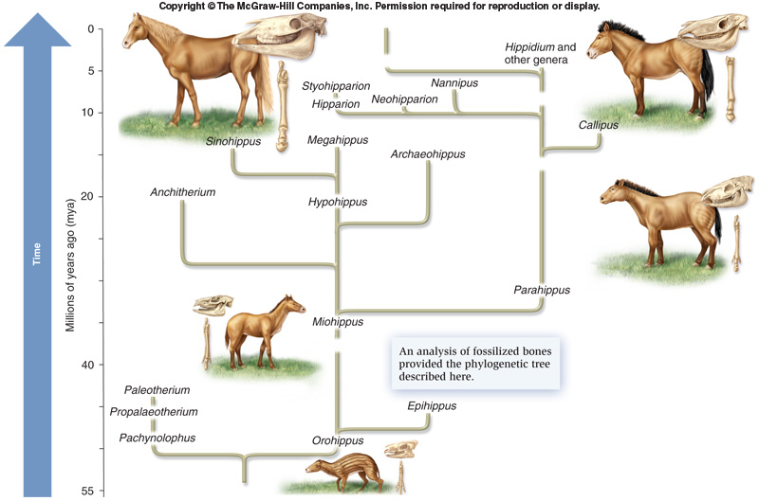

Slide 33
Summation
Species that endure the longest and have most offspring determine the direction of major evolutionary trends.
An evolutionary trend does not imply that there is some intrinsic drive toward a particular phenotype.
Evolution is the result of interactions between organism and its current environment.
Value of an evolutionary trend may vanish when environment changes.

