Slide 1
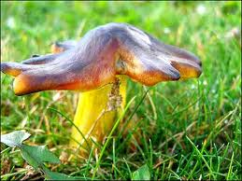
Kingdom: fungi

Slide 2
Fungi are multicellular heterotrophs that feed by absorption
Fungi secrete hydrolytic enzymes, digest food outside their bodies, and absorb small molecules.

Slide 3
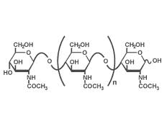
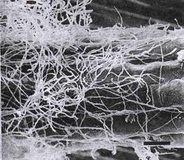
Structure of Fungi
Cell walls are made of chitin
Bodies are composed of filaments called hyphae that are entwined to form a mass, the mycelium.

Slide 4
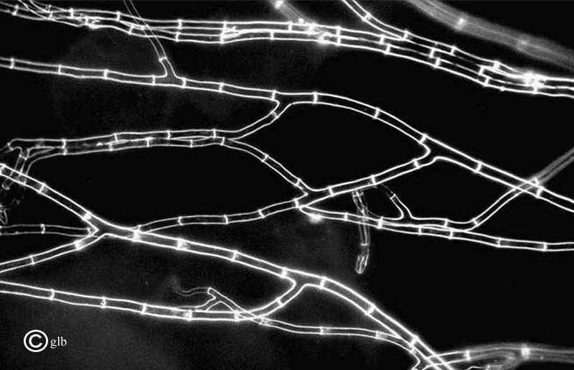
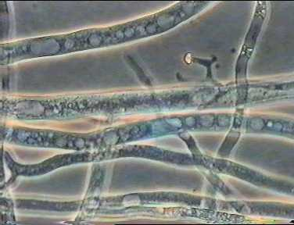
Most fungi are multicellular
Hyphae are divided into cells by cross walls called septa.
Coenocytic fungi lack septa and consist of a continuous cytoplasmic mass containing hundreds of nuclei.

Slide 5
Five Phyla of Fungi
Chytridiomycetes are aquatic and form motile zoospores.
Zygomycetes have coenocytic hyphae and produce only one diploid cell, the zygote, in their entire life.
Glomeromycetes are the arbuscular mycorrhizae (fungus that associates with the roots of plants).
Ascomycetes are called the “sac fungi” and produce sexual spores in a structure called the ascus.
Basidiomycetes are the “club fungi” and produce sexual spores in a structure called the basidium.

Slide 6
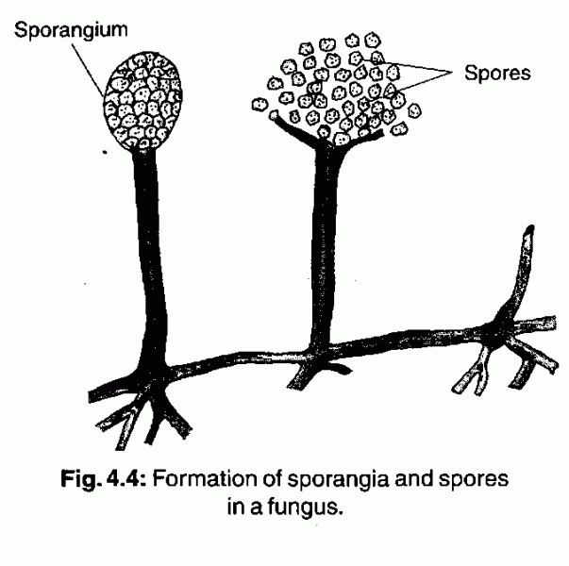
Fungi reproduce by spores
Fungi are placed into phyla based on the reproductive structure that produces sexual spores.

Slide 7
Fungi reproduce both asexually and sexually
Asexual:
Production of haploid spores within sporangium
Equal cell division by fission of unicellular fungi or unequal division by budding
Production of naked spores, called conidia (not in sporangium) at tips of hyphae
Simple breakage of the mycelium

Slide 8
Sexual Reproduction in Fungi
No distinction between male and female
Have (+) and (-) mating types
Individuals with the same mating type cannot mate
Genetically different, but often not visibly different
Mating types meet and fuse, zygote undergoes meiosis and produces haploid spores.
Haploid spores produce a haploid mycelium.

Slide 9
The dikaryotic condition
In some fungi, the fusion of the nuclei, karyogamy, occurs long after the fusion of the cytoplasm, plasmogamy.
This results in hyphae called a dikaryon, or having two genetically different, haploid nuclei in the same hyphae.
Zygote is formed long after original mating.
Hyphae is neither haploid (n) or diploid (2n), but rather (n+n).
Dikaryotic condition can exist for months or even years.

Slide 10
Deuteromycetes are fungi for which no sexual stage has been observed and have not yet been placed into a group

Slide 11
Representative Phyla
Zygomycetes produce gametangia that fuse to form a zygosporangium within which a zygospore (a single cell containing many diploid nuclei) develops.
Zygomycetes have coenocytic hyphae.

Slide 12
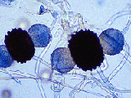

Slide 13
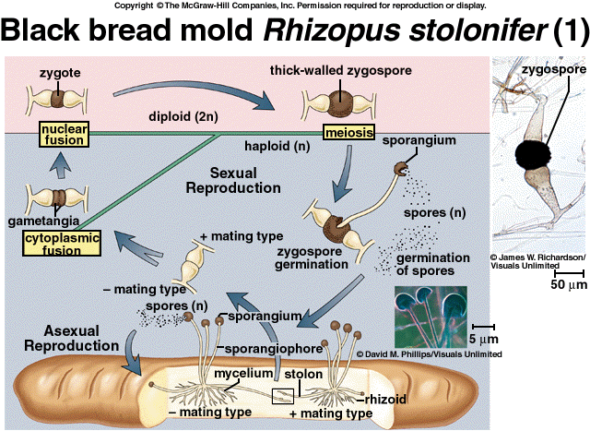
Zygomycete Life Cycle

Slide 14
Ascomycetes produce their sexual spores in a sac like structure called an ascus.
Yeast are unicellular ascomycetes.
True ascomycetes produce fleshy fruiting bodies called ascocarps.
Ascomycetes have septate hyphae.

Slide 15
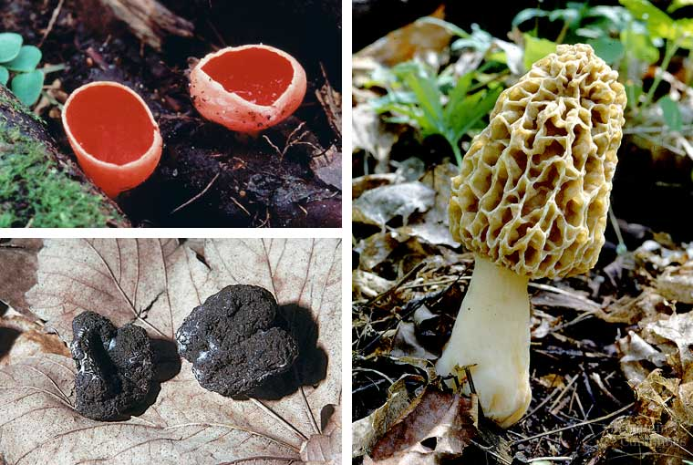

Slide 16
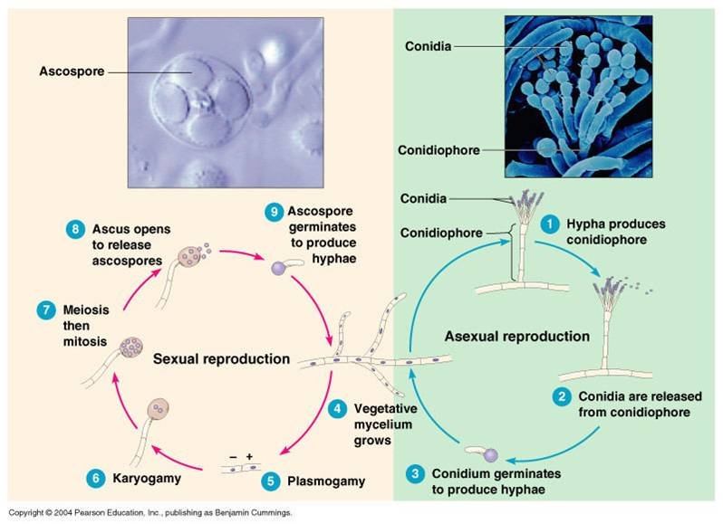
Ascomycete Life Cycle

Slide 17
Basidiomycetes produce their sexual spores in a structure called the basidium.
Basidia are club shaped structures that form a larger structure called the basidiocarp.
Basidiomycetes have septate hyphae.
Their dikaryon stage may last for years.

Slide 18
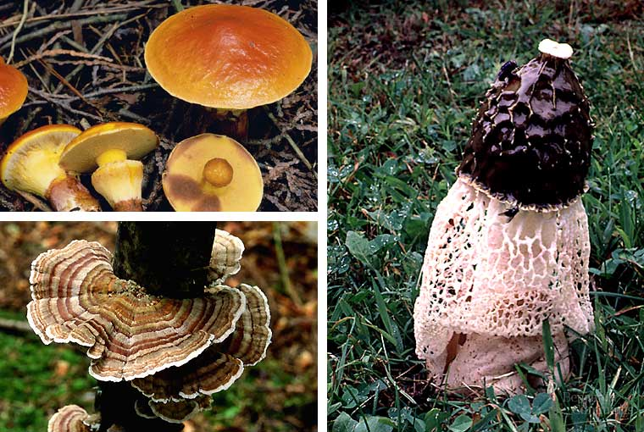

Slide 19
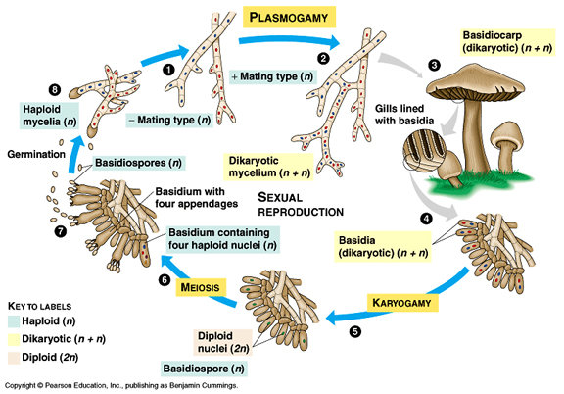
Basidiomycetes Life Cycle

Slide 20
Importance of Fungi
Decomposers of organic material
Mycorrhizal fungi found in association with plant roots and improve absorption of water and minerals to plant while being supplied with organic nutrients.
Lichens are symbiotic associations of photosynthetic microorganisms (algae) and fungus. Pioneer organisms on rock and soil surfaces.
30% of known species of fungus are parasites. Many are plant pathogens.

Slide 21
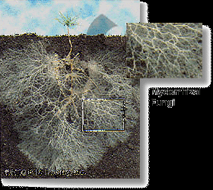
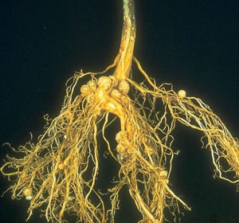
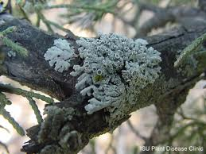
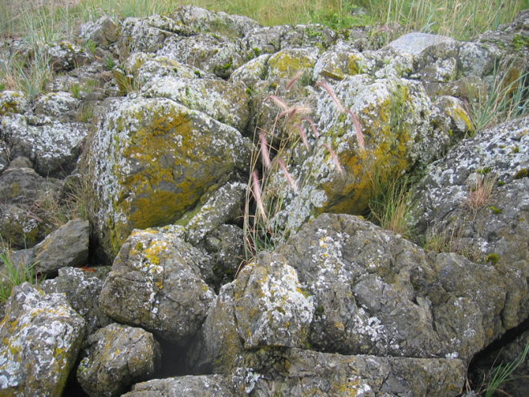
Mycorrhizal fungi
Lichens

